Slide 1
Linear Models I: Linear regression, ANOVA, ANCOVA and repeated measures (a simple mixed model)
Presented by
Chris Howden
Sydney Informatics Hub
Core Research Facilities
The University of Sydney
Notes:
INTRO: KEEP IT SHORT IF I AM GOING TO DO THIS IN 5 MIN
Setting a Positive impression and tone of the workshop. Whet learners appetite
Introduce yourself effectively (and have other workshop leaders do the same)
Example:
Hi Everyone, My name is Chris Howden and I am the lead at the statistics unit at the Sydney Informatics Hub. I have about 20 years experience across the Academic, Public and Commercial sectors. Today I’ll be using that bring you Practical workflows and tips you can use in your research, this isn’t about the theory!! Its about hands on useful workflows.
We also have XX who will be answering your questions in the chat, so please feel free to ask them in there. And to also ask me questions verbally as we go.
ALSO GET THEIR VIDEO ON BY SAYING
“If you could pls turn on yr video to say hi that’d be great”
Really appreciate if you could leave them on makes it much easier for me if I am talking to people not a blank screen. Plus I can see your confused faces if I need to explain something again.
Thanks”

Slide 2

Acknowledging SIH
All University of Sydney resources are available to Sydney researchers free of charge. The use of the SIH services including the Artemis HPC and associated support and training warrants acknowledgement in any publications, conference proceedings or posters describing work facilitated by these services.
The continued acknowledgment of the use of SIH facilities ensures the sustainability of our services.
Suggested wording:
General acknowledgement:
"The authors acknowledge the technical assistance provided by the Sydney Informatics Hub, a Core Research Facility of the University of Sydney."
Acknowledging specific staff:
“The authors acknowledge the technical assistance of (name of staff) of the Sydney Informatics Hub, a Core Research Facility of the University of Sydney.”
For further information about acknowledging the Sydney Informatics Hub, please contact us at sih.info@sydney.edu.au.

Slide 3
We value your feedback
We aim to help HDR students and researchers in a wide range of fields across different faculties
We want to hear about you and whether this workshop has helped you in your research.
Later in this workshop there will be a link to a survey
It only takes a few minutes to complete (really!)
Completing this survey will help us create workshops that best meet the needs of researchers like you

Slide 4



During the workshop
Ask short questions or clarifications during the workshop. There will be breaks during the workshop for longer questions.
Slides with this blackboard icon are mainly for your reference, and the material will not be discussed during the workshop.
Challenge Question
A wild boar is coming towards you at 200mph. Do you:?
  A. Ask it directions
  B. Wave a red flag
  C. Wave a white flag
  D. Begin preparing a trap

Slide 5
After the workshop
These slides should be used after the workshop as Workflows and reference material.
Todays workshop gives you the statistical workflow, which is software agnostic in that they can be applied in any software.
There are also accompanying software workflows that show you how to do it. We won’t be going through these in detail. But if you have problems we have a monthly hacky hour where people can help you.
1on1 assistance
You can email us about the material in these workshops at any time
Or request a consultation for more in-depth discussion of the material as it relates to your specific project. Consults can be requested via our Webpage (link is at the end of this presentation)

Slide 6
Research Workflow
Why do we use a research workflow?
  As researchers we are motivated to find answers quickly
  This drive can cause problems if we don’t think systematically
  … and we need to in order to:
    Find the right method
    Use it correctly
    Interpret and report our results accurately
  The payoff is huge, we can avoid mistakes that would affect
  the quality of our work and get to the answers sooner
So… what is a workflow?
  The process of doing a statistical analysis follows the same general “shape”.
  We provide a general research workflow, and a specific workflow for each major step in your research
  (currently experimental design, power calculation, analysis using linear models/survival/multivariate/survey methods)
  You will need to tweak them to your needs
Notes:
SCRIPT
The reason we use a workflow is that it helps us:
Find the Optimal analysis that finds the most interesting patterns. That helps us get published in the better journals.
Workflow is a bit of a recipe. It’s not the same for everyone, Different chefs and different cooks may change things a little. There is nothing wrong with you taking what we are give you and tweaking it for your needs or domain.

Slide 7











General Research Workflow
Hypothesis Generation (Research/Desktop Review)
Experimental and Analytical Design (sampling, power, ethics approval)
Collect/Store Data
Data cleaning
Exploratory Data Analysis (EDA)
Data Analysis aka inferential analysis
Predictive modelling
Publication
Notes:
Today I’m talking about these 2.

Slide 8
CONTENTS: Linear Models I - An Introduction
A Statistical Workflow for most Linear Models, software agnostic
Applicable in any software
There is accompanying R code if you wish to do it in R. Plots are done using a combination of default plotting functions and ggplot functions. You will know the difference since ggplot functions start with ggplot().
Applied workflows to 4 of the most common analyses on a continuous response:
Simple Linear Regression (continuous predictor)
ANOVA on Control vs Treatment (categorical predictor)
Continuous and categorical predictor (ANCOVA example)
Repeated measures
The first example introduces the basic concepts and workflow so we don’t show you how to do it in R or SPSS. Subsequent examples will have R code.

Slide 9
What are Linear Models?
ANOVA
Linear Regression
ANCOVA
Logistic regression
Before After Control Impact (BACI) Studies
Count regression
Randomised Control Trials (RCT’s)
Repeated measures
Plus Many More!!

Slide 10
A Single Unifying Theory
Regression and ANOVA are often taught as different things. Yet they aren’t!
An easier way to understand them is with the single unifying Linear Models theory.
This allows us to apply them using the same workflow on different outcomes and predictors types.
Meaning we only need to write up one set of methods based on GLM, saving time and reducing manuscript length.

Slide 11
Model Fitting Workflow
Step 0) Clean and check data.
Step 1) Pick a suitable model to fit to the data via Exploratory Data Analysis (EDA).
Step 2) Fit the Model
Step 3) Check Model Assumptions via Diagnostics: Residual Analysis
Step 4) Goodness of Fit: Plots and Statistics
Step 5) Interpret Model Parameters and reach a conclusion
Step 6) Reporting
Linear Models 3 and Model Building Workshops have more detail on many of these steps.

Slide 12
Step 0) Clean and check data
Is covered in “Research Essentials”, not this workshop.
Is very important, so ensure you do it!
Get in the habit of checking the data every time you open it by looking at the corners i.e. start at the top left corner, then scroll to the far right corner, scroll down to the bottom right corner, scroll left to the bottom left corner, then finish by scrolling pack up to the beginning top left corner.
  Weird things can happen. New versions, a stray cosmic ray. I have literally opened data to find it corrupted, and then reopened it and it’s fine. Similarly I have seen weird results only to rerun them to find them OK.

Slide 13
Simple Linear Model
Continuous response and predictor
Workflow Suitable for:
Modelling continuous predictors (workflow shown is for 1 predictor, there are additional considerations when more than 1 e.g. multicollinearity, these are discussed in our Model Building workshop)
Least Squares Regression
Simple Linear Regression
Notes:
I’m about to show you a workflow that is suitable for all these things. So if you ever need to do this you can come back here and use this as a workflow.

Slide 14
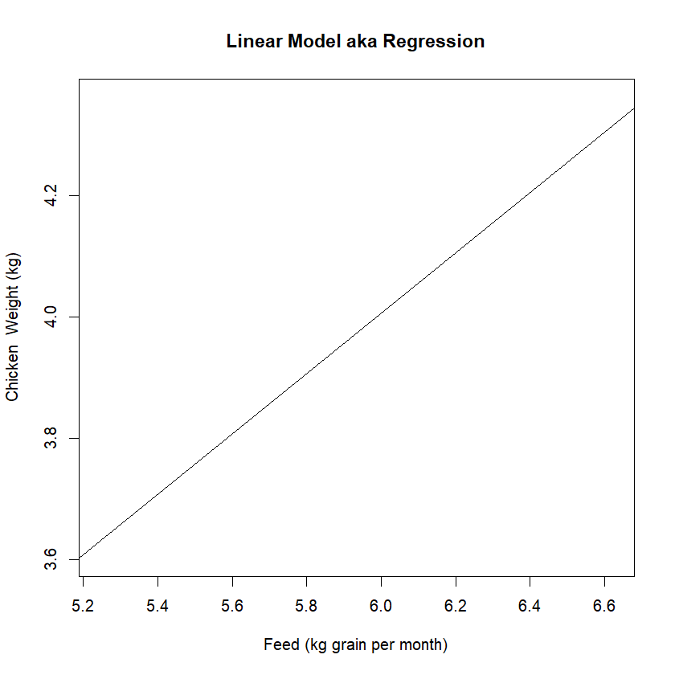
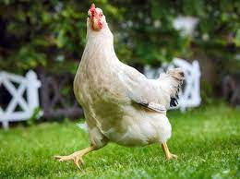
Simple Linear Model
Your Turn: Draw a linear model for the weight of chicken compared to the amount of feed it eats in its first month.
So in this example a chicken that eats 6 kg of Feed will weigh about 4kg

Slide 15
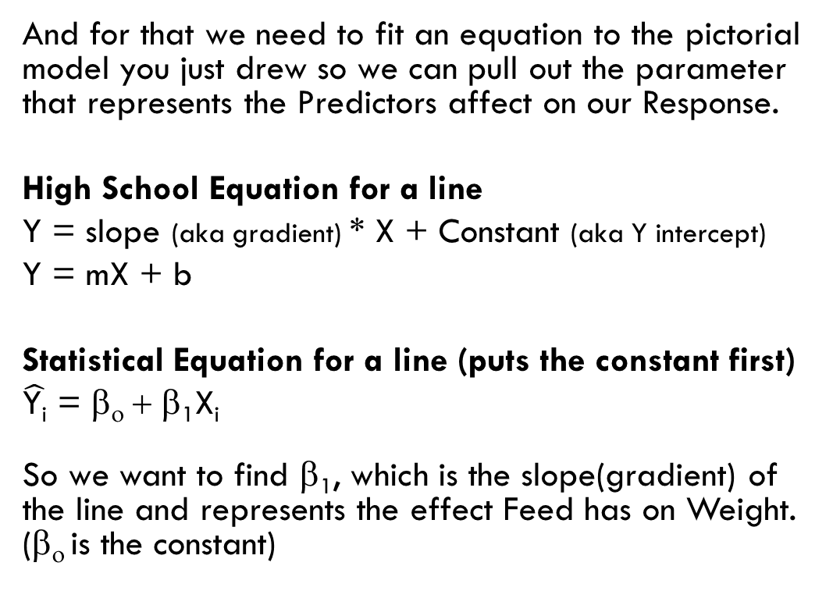
So we know it’s linear. Is that all we need to know?
NO! We want to know exactly how our Predictor (feed) affects our Response (weight).
And for that we need to fit an equation to the pictorial model you just drew so we can pull out the parameter that represents the Predictors affect on our Response.
High School Equation for a line
Y = slope (aka gradient) * X + Constant (aka Y intercept)
Y = mX + b
Statistical Equation for a line (puts the constant first)
$\hat{\text{Y}\text{i}}$ = β_{ο} + β₁X_{i}
So we want to find β₁, which is the slope(gradient) of the line and represents the effect Feed has on Weight. (β_{ο} is the constant)

Slide 16
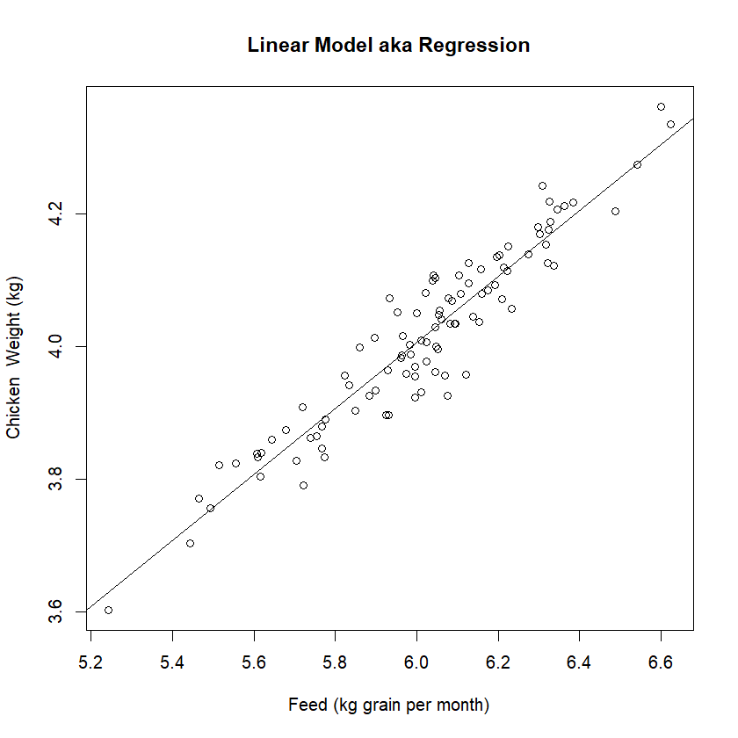
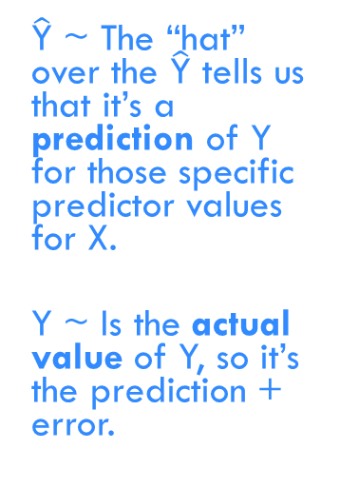
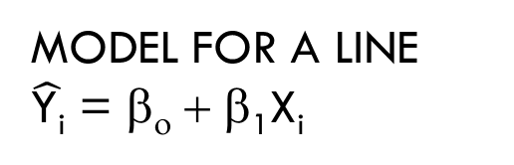
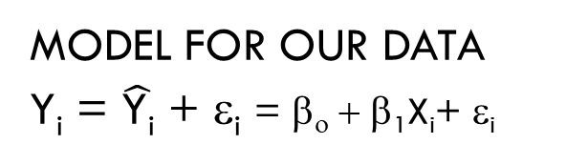
But we’re still missing something?
THE DATA!!!!!
Each datum has its own natural variance from the line since each chicken is a bit different!
Another name for the natural variance is the error of the model. Which is why we usually represent it as an ε in the model. In reality, model error is usually a combination of natural variance and model error. Including this natural variation is one difference between deterministic mathematical/physics models and statistical models.
MODEL FOR A LINE
$\hat{\text{Y}\text{i}}$ = β_{ο} + β₁X_{i}
MODEL FOR OUR DATA
Y_{i} = $\hat{\text{Y}\text{i}}$ + ε_{i} = β_{ο} + β₁X_{i}+ ε_{i}
$\hat{\text{Y}}$ ~ The “hat” over the $\hat{\text{Y}}$ tells us that it’s a prediction of Y for those specific predictor values for X.
Y ~ Is the actual value of Y, so it’s the prediction + error.

Slide 17
So how do we use this equation to understand the relationship between our predictor and response?
We look at the Parameter estimates of the model.
Parameter | Estimate | SE | T score | P value | 95% Confidence Interval
 |  |  |  |  | Lower Bound | Upper Bound
Constant / Intercept (β_{ο}) | 1.03 | 0.136 | 7.6 | 2.24e-11 | 0.8 | 1.3
Feed (β1) | 0.50 | 0.023 | 21.8 | <2e-16 | 0.45 | 0.54
Model Fit is => Y_{i} = β_{ο} + X_{i}β₁ + ε_{i} => Weight = 1.03 + 0.50 * Feed + ε_{i}
Notation 2.24e-11 means move the decimal place to the left 11 places i.e. 2.24e-11 = 0.0000000000224. It is done so we can write small numbers concisely.
Notes:
So here’s a table that has all the info we need to interpret what the model is telling us about the relationship between our predictor and response.

Slide 18
So how do we use this equation to understand the relationship between our predictor and response?
We look at the Parameter estimates of the model.
Parameter | Estimate | SE | T score | P value | 95% Confidence Interval
 |  |  |  |  | Lower Bound | Upper Bound
Constant / Intercept (β_{ο}) | 1.03 | 0.136 | 7.6 | 2.24e-11 | 0.8 | 1.3
Feed (β1) | 0.50 | 0.023 | 21.8 | <2e-16 | 0.45 | 0.54
Model Fit is => Y_{i} = β_{ο} + X_{i}β₁ + ε_{i} => Weight = 1.03 + 0.50 * Feed + ε_{i}
First we look at the constant (β_{ο}), to ensure it’s needed and there is nothing weird going on. So we can say:
It is likely different to 0 (since p=2.24e-11 which is very small so it is very unlikely we are making the wrong decision if we say this).
It is likely somewhere between 0.8-1.3.
Notes:
So here’s a table that has all the info we need to interpret what the model is telling us about the relationship between our predictor and response.

Slide 19
So how do we use this equation to understand the relationship between our predictor and response?
We look at the Parameter estimates of the model.
Parameter | Estimate | SE | T score | P value | 95% Confidence Interval
 |  |  |  |  | Lower Bound | Upper Bound
Constant / Intercept (β_{ο}) | 1.03 | 0.136 | 7.6 | 2.24e-11 | 0.8 | 1.3
Feed (β1) | 0.50 | 0.023 | 21.8 | <2e-16 | 0.45 | 0.54
Model Fit is => Y_{i} = β_{ο} + X_{i}β₁ + ε_{i} => Weight = 1.03 + 0.50 * Feed + ε_{i}
Next, we investigate if there is an association between Feed and Weight which is represented by β1:
It is likely different to 0, (since p<2e-16 which is very small so it is very unlikely we are making the wrong decision if we say this).
The effect is likely somewhere between 0.45-0.54. Or in other words for each extra kg of Feed eaten we expect a chicken to weigh between 0.45-0.54 kg more.

Slide 20
P values give us the weight of evidence in making a yes/no decision, they don’t make it for us
Don’t simply make no brain decisions like ‘yes there is an effect’ if the p-value is < 0.05.
If p = 0.05, this means you can be wrong as often as 1 in 20.
A p = 0.0000001 is much stronger evidence!! i.e. wrong 1 in a million.
A p=0.049 and p=0.051 is about the same evidence.
Use the p-value to understand your decision. Are you saying there is an effect with a lot of confidence since there is a very small chance you have made the wrong decision (p=0.0000001), or should you be a bit cautious in saying there is an effect since there is a high chance you have made the wrong decision (p=0.05)?

Slide 21
So, is that all we need to do? Is our Analysis finished, can we now write up our conclusions?
NO, because Computers are Stupid!!
Because a computer will fit any model you tell them to even if:
It’s a bad fit to the data
It’s a stupid fit to the data
So it’s up to YOU to decide if the model you are asking the computer to fit to your data is the right type and a good fit.
Because if it’s a bad fit, then the parameters and conclusions we draw from them will be wrong. And there is little in the previous parameter table to warn you of this!!!!! So we need to look at other things.

Slide 22
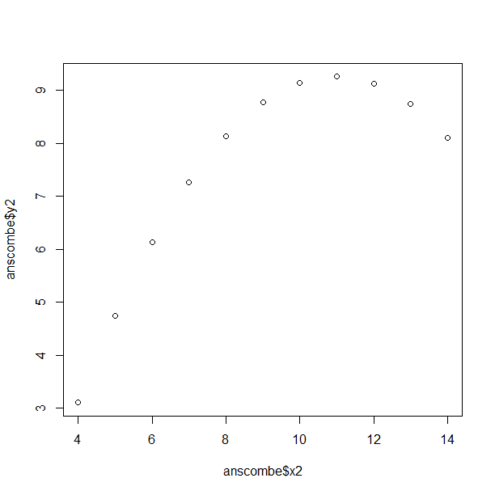
Your Turn: Draw the best fit to this data

Slide 23
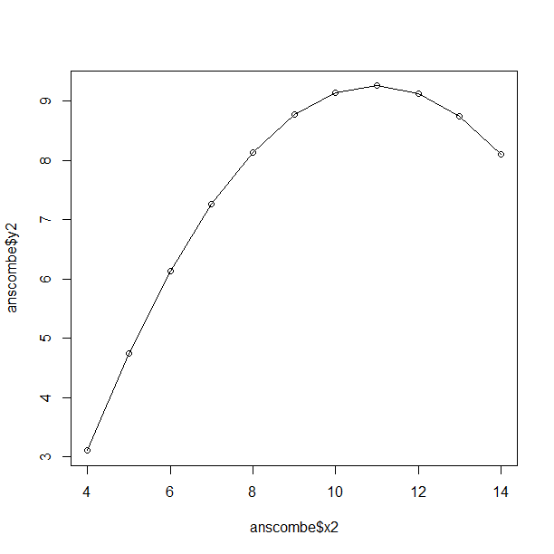
Your Turn: Draw the best fit to this data
Hopefully You drew this.
Now draw a linear fit.

Slide 24
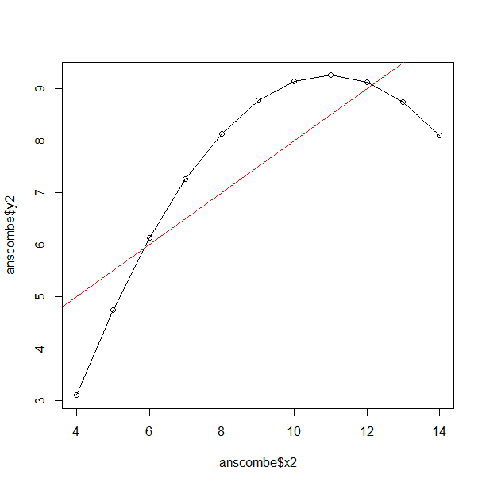
Your Turn: Draw the best fit to this data
Which model do you think a computer fits if you ask it to do a linear regression?
The wrong (linear) one! Because Computers are Stupid.

Slide 25
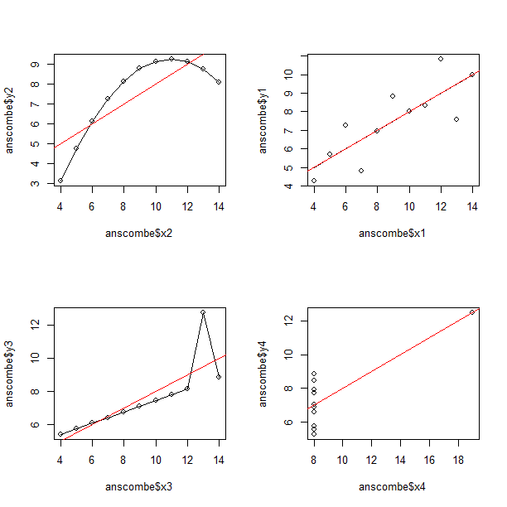
This is just one example from Anscombe’s Quartet, 4 data sets all with the same linear fit. But only one is actually linear.

Slide 26
So how do we decide if the model we are asking the computer to use is a good enough fit to the data that the parameters, and the conclusions we make from them, make sense?
Exploratory Data Analysis (EDA)
  Plot the data to look for linearity (response vs predictor), correlation (serial plots), non-normality (histograms/kernel density plots), etc.
  DO NOT SKIP THIS STEP. It gives you an understanding of the data which allows you to find common problems, select an appropriate model, and Common Sense Check your model, its assumptions and conclusions. Skipping this step is one of the most common problems we see in consults.
Check Model Assumptions via Diagnostics
  Linearity
  Normal Error
  Independence
Check Model Goodness of Fit
  How much of the response variance does the model explain?
  Is the model a good fit of the data overall, or is it biased towards explaining just a couple datum?

Slide 27
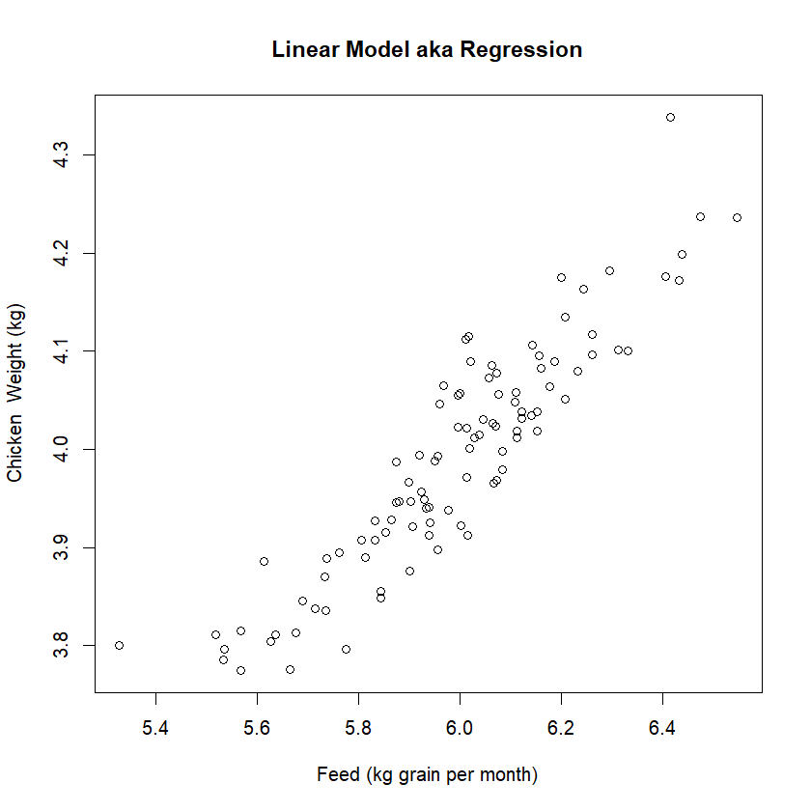
Step 1) Pick a suitable model to fit to the data via Exploratory Data Analysis (EDA)
Linearity: Draw A Graphical model of the data
Simply plot the data and have a look. Is a linear model a good fit to the data?
Try to write down the model you want to fit as well. This will help you interpret what the β Parameters mean, particularly for complicated models.
  Y_{i} = β_{ο} + X_{i}β₁ + ε_{i}

Slide 28
Step 1) Pick a suitable model to fit to the data via Exploratory Data Analysis (EDA)
Independence: Consider your experimental design
Is there anything about it that might lead to datum being correlated with each other. For example, if we had repeated measures on the same patient (chicken) then we would expect these to be correlated i.e. dependant on each other.
Modelling independence correctly is important for 3 main reasons:
Ensures the correct sample size is used. For example, if I measured the chickens weight 100 times a second for 60 seconds do a really have 6000 samples per chicken? NO, of course not. Because the 6000 samples aren’t independent. This is known as Pseudo Replication and inflates our sample size, lowering our standard errors and making our p-values too low and confidence intervals too narrow.
  This is one reason for the replication crisis i.e. artificially low p-values.
Partitioning out extra sources of error/noise which makes our analysis more accurate, which is done using mixed models for designs such as split-plots, blocked, repeated measures.
Structural correlation that should be added to the model e.g. serial correlation such as auto-regressive correlation.
  Stock prices are independent day to day (since something can happen to change their price) but are heavily dependent on the prior days price.

Slide 29
Step 1) Pick a suitable model to fit to the data via Exploratory Data Analysis (EDA)
Experimental Design workshop covers these topics, how to optimise designs to include them and hence have more accurate analysis and results.
Independence: Consider your experimental design
Is there anything about it that might lead to datum being correlated with each other. For example, if we had repeated measures on the same patient (chicken) then we would expect these to be correlated i.e. dependant on each other.
Modelling independence correctly is important for 3 main reasons:
Ensures the correct sample size is used. For example if I measured the chickens weight 100 times a second for 60 seconds do a really have 6000 samples per chicken? NO, of course not. Because the 6000 samples aren’t independent. This is known as Pseudo Replication and inflates our sample size, lowering our standard errors and making our p-values too low and confidence intervals too narrow.
  This is one reason for the replication crisis i.e. artificially low p-values.
Partitioning out extra sources of error/noise which makes our analysis more accurate, which is done using mixed models for designs such as split-plots, blocked, repeated measures.
Structural correlation that should be added to the model e.g. serial correlation such as auto-regressive correlation.
  Stock prices are independent day to day (since something can happen to change their price) but are heavily dependant on the prior days price.

Slide 30
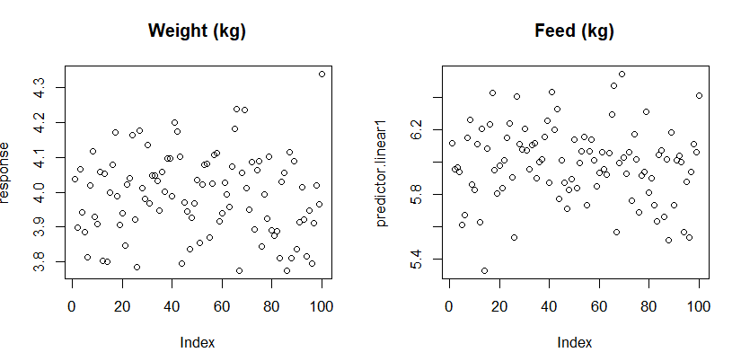
Step 1) Pick a suitable model to fit to the data via Exploratory Data Analysis (EDA)
Independence: Plot the data using a “Serial Plot” i.e. data plotted 1 after each other
This is simply a plot of the data, one after each other, as recorded in your data. You are looking for unexplained sequences of high or low values i.e. unexplained correlations.
You can also organise your data into different structures to look for different types of dependence e.g. if repeated measures then organise so each persons (chickens) data is sequential.
You can also plot lag correlations.

Slide 31
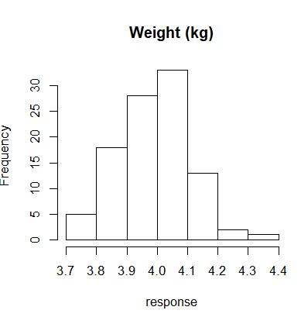
Step 1) Pick a suitable model to fit to the data via Exploratory Data Analysis (EDA)
Normality
This is a very poorly understood assumption. The assumption is that the Error, not the Response is normal. Meaning we can’t test it until we fit a model. So don’t make the mistake of thinking just because your data isn’t normal this assumption has been violated.
What we can do is consider exactly what it is we are modelling and also look at the response using a histogram to see if a normal error might not fit. Obviously if the response looks normal there is a good chance the errors will be too. However, a non-normal response can have a normal error (which I will show you when we look at ANOVA).
The main thing we are looking for here are things that usually prevent the error from being normal and are better fit using different models such as the response being non continuous (e.g. binary or counts), extreme outliers, extreme skewness, and truncation.
It’s worth noting that discrete data can be modelled using a normal error under some circumstances e.g. weight rounded to the nearest gram is technically discrete, but can be fit using a normal error. Counts can also be fit using a normal error if large enough.

Slide 32
Minor deviations from normality are OK
These models are very robust to minor deviations from normality.
When looking at the residual quantile plot the data does not need to be exactly on the 1:1 line. Which is why I suggest looking at the histograms and density plots, as they are more intuitive when assessing the residuals distribution.
Be very wary of using significance tests such as Shapiro-Wilk and Kolmogorov-Smirnov to evaluate if the residuals are non normal as they often detect statistically significant differences, that are so small as to not matter. This is particularly a problem with large sample sizes as they can detect very minor deviations from normality that have no real impact.

Slide 33
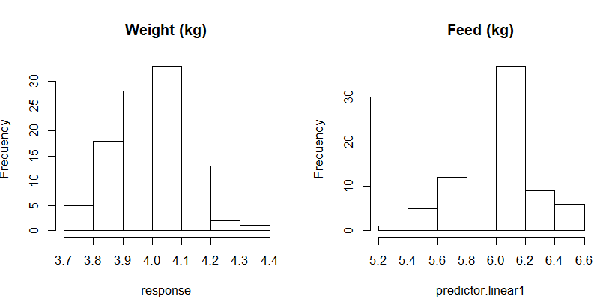
Step 1) Pick a suitable model to fit to the data via Exploratory Data Analysis (EDA)
Outliers
This is a also very poorly understood assumption. We want a model represent the bulk of the data. We don’t want it biased towards 1 or 2 outlying influential points. Just like checking the normality assumption we can only test this for sure once we have fit a model. However, it is always worth looking at all our data to see if there are any outliers we might need to deal with. The best way to do this is via histograms or boxplots.
Notes:
NOTE: a response outlier might be very high/low due to a unique combination of the predictors, allowing it to still be a good fit to the model and not a model outlier.

Slide 34
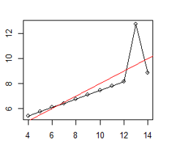
Fixing Model Assumption Problems
Outliers
Check to see if they are a data entry or collection mistake and can be removed.
Consider transformations that reduce their influence e.g. log transforms will reduce the influence of large outliers.
Consider removing them to get a model that is a better fit to the majority of the data. If this is done one must say so in any reporting. For example: looking at the Anscombe example on the right. What is a better model. A line through the datum in a straight line, while saying there was a single large outlier. Or the red line shown?
Consider other models that can handle the outliers.
e.g. quantile regression.

Slide 35
Fixing Other Model Assumption Problems
This is a complex business and is beyond the scope of this workshop. It is covered in more detail in other Linear Model courses we give. The quick answer is that you will usually need to use a different model. In brief:
Non linear fit
Add in quadratic and non linear terms for either the predictors or the response (GLM’s can add such terms for the response via the link function as Discussed in Linear Models II.).
Use a non linear model such as a General Additive Model (GAM).
Normal error is inappropriate
Use a different type of linear model. A Generalised Linear Model (GLM) with a different error distribution often works e.g. binomial for binary data (logistic regression), Poisson for count data. Discussed in Linear Models II. Distributional regression should be explored if a GLM won’t work as it can fit a wider range of distributions.
Lack of Independence
Fit a mixed model that accounts for the correlation structure. Discussed in Linear Models I and III.
Remove datum until they are independent (also known as censuring).
Average the independent data e.g. average the 6000 chicken weights so we have a single score. Has the advantage of also usually making the data normally distributed, by invoking the Central Limit Theorem (CLT)
Five extensions of the general/simple linear model which may help
https://www.theanalysisfactor.com/extensions-general-linear-model/
Notes:
Give the some quick options

Slide 36
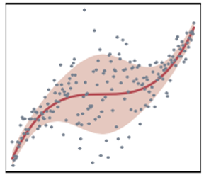
Fixing Other Model Assumption Problems
Distributional Regression: regression beyond the mean
Distributional Regression models extend GLM’s in 2 ways:
Fit a wider range of distributions
Can model not just the mean but other properties such as the variance and skewness i.e. moments, of a variety of different distributions. Allowing us a flexible way to overcome the assumption violations of other models.
It also becomes useful if we think these other moments are dependent on an explanatory variable.
Looking only at the mean (with LM, GLM, GAM) might miss the bigger picture: For example, a treatment effect on the variance of blood pressure.
Taking the data set on the right as an example:
A GLM would try to fit a line to it.
A GAM would fit the curve, but not capture
the wider variance in the middle.
While distributional regression provides a
good non-linear fit for the mean, and allows the
variance to differ along the mean predictions,
with more variance in the middle.

Slide 37
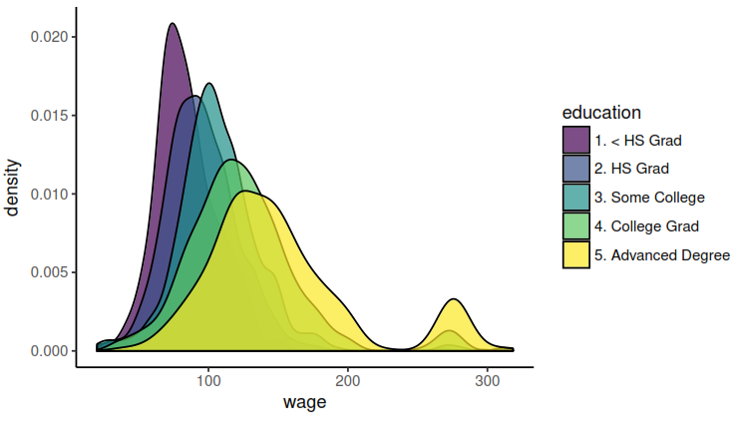
Not only is average wage associated with education level, but so is the expected range of income.
With Distributional Regression we can quantify how the income variability changes with education level.
Knowing there is higher variability in different groups can be important when making policy decisions e.g. one might need a wider range of options for those groups with more variability. It allows the predicted distributions for income to have different widths for each education level, making the overall
95% CI for the mean more
accurate.

Slide 38
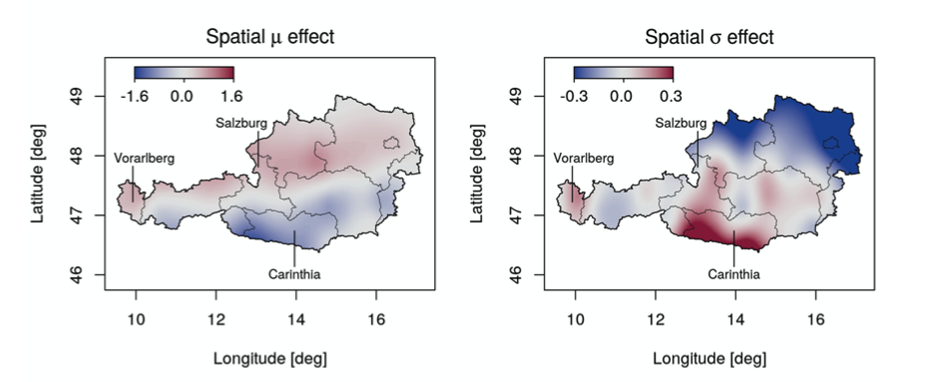
Austrian rainfall predictions
Using distributional regression, we can see that there is a spatial effect on the mean precipitation, and also on precipitation variability.
Knowing there is higher variability in rainfall is important when making infrastructure and agricultural decisions. If 2 areas have the same average rainfall, but one got that rainfall consistently while the other had drought years this means that the former is good for perennial tree crops like citrus, almonds, etc. While the latter is better for annual crops like wheat, and would also benefit with a more regulated river system (i.e. dams to store water).

Slide 39

Software
R packages:
gamlss (vast variety of distributions) - recommended
bamlss (Bayesian Distributional Regression)
VarReg
mgcv (for select distributions)

Slide 40
References
Hohberg M, Pütz P, Kneib T. Treatment effects beyond the mean using distributional regression: Methods and guidance. PLoS One. 2020 Feb 14;15(2):e0226514.
Heller GZ, Robledo KP, Marschner IC. Distributional regression in clinical trials: treatment effects on parameters other than the mean. BMC Med Res Methodol. 2022 Feb 27;22(1):56.
Kneib, T., Silbersdorff, A., & Säfken, B. (2021). Rage against the mean–a review of distributional regression approaches. Econometrics and Statistics.

Slide 41
Step 2) Fit the Model
Use your software of preference to fit the model.
In R you’d use something like this:
> regression <- lm(response~predictor.linear1)
> regression <- lm(weight~feed, data=data)

Slide 42
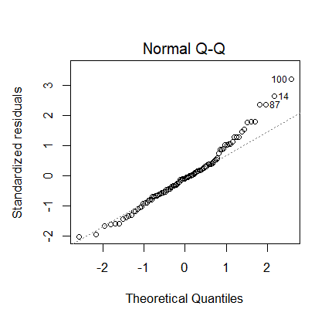
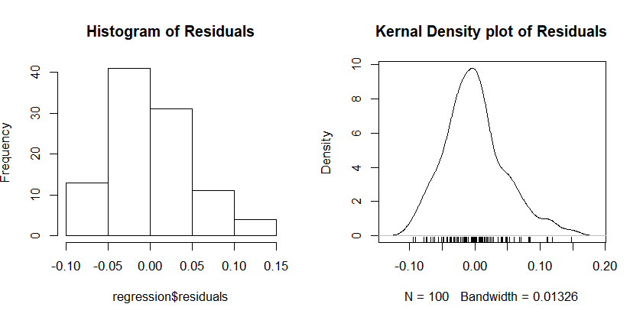
Step 3) Check Model Assumptions via Diagnostics: Residual Analysis
Normality
The QQ plot is pretty standard, if normal residuals should be along the straight 1:1 line. I also like a histogram and density plot since these are easier to see the actual distribution and diagnose problems.
  QQ plots are very sensitive. In this example we know the underlying error is normal (since we simulated it) yet one might not think that from the QQ plot.
Formal significance tests e.g. Shapiro-Wilk and Kolmogorov-Smirnov are notoriously over sensitive, do not rely on them. They often detect deviations from normality that are not severe enough to substantively impact model interpretation.
Linear models are very robust to the normality assumption.

Slide 43
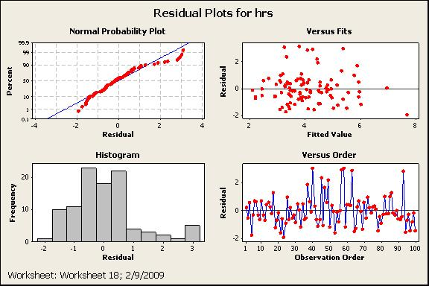
Non-normal Error Example 1
Often fixed by fitting a non normal error, transformations or adding new predictors that account for the non normality. In this example a natural log of the response fixed the problem.
https://smartersolutions.com/multiple-regression-dealing-with-non-normal-residuals.html/
Notes:
Give the some quick options

Slide 44
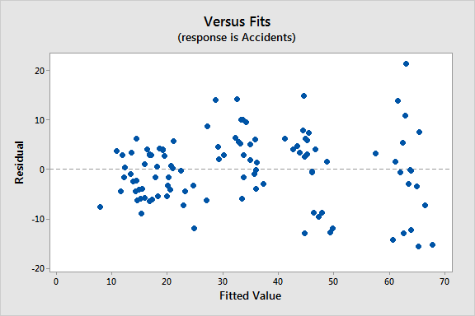
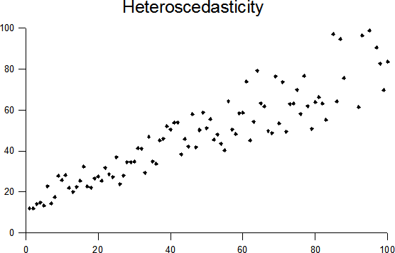
Non normal error Example 2: Heteroscedasticity i.e. variance not constant
Left graph: residuals showing heteroscedasticity. https://statisticsbyjim.com/regression/heteroscedasticity-regression/
Right graph: raw data with heteroscedasticity, and a linear model. https://en.wikipedia.org/wiki/Homoscedasticity_and_heteroscedasticity
Common with count, rate and concentration data as we expect a count of 10000 to have higher variance than a count of 1. Often fit with a GLM and Poisson distribution as discussed in Linear Models II. Can also be fixed by log transforming the response when fitting a normal error.
Notes:
Give the some quick options

Slide 45
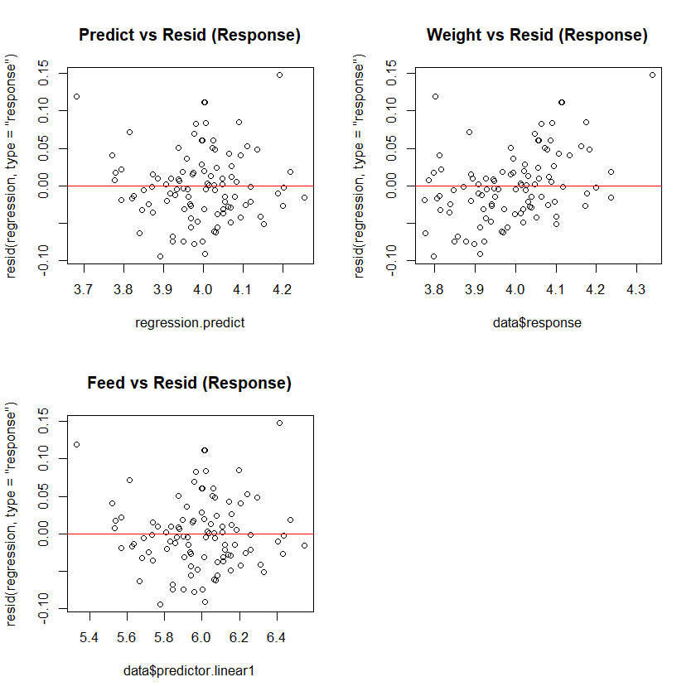
Step 4) Goodness of Fit: Residual Analysis
Is there any unexplained structure, non linearity or non constant variance?
We want to see our residuals randomly scattered about zero since this indicates a fit that is:
  consistent across the different predicted, response and predictor values.
  with no unexplained structure our model has missed.
Patterns can indicate:
  Missing predictors
  Incorrect Error
  Non linear fit e.g. quadratic
No evidence of non constant
Variance i.e. heteroscedasticity.
Any Outliers
No

Slide 46
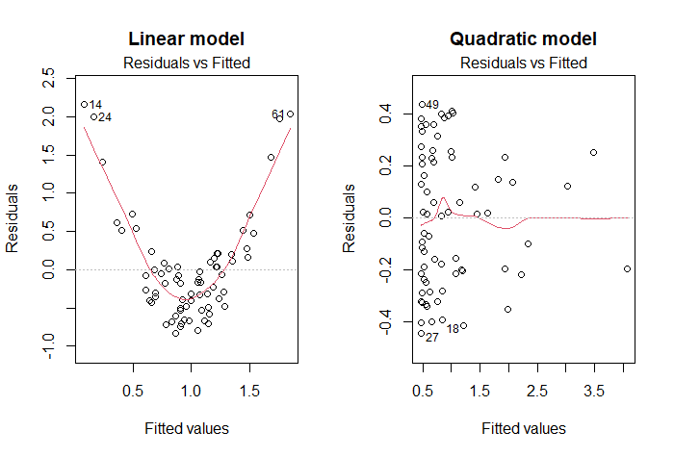
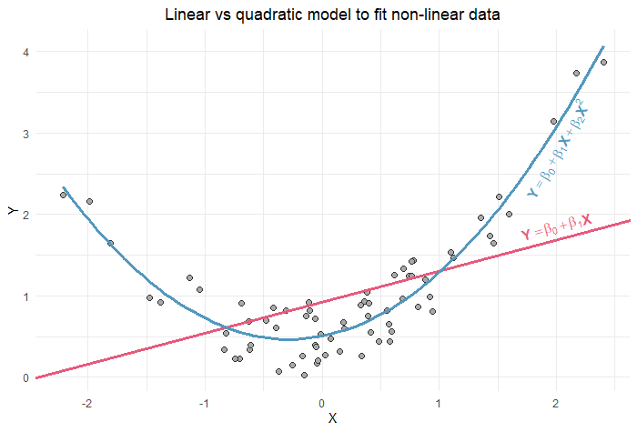
Non Linear Fit Example 1: Residuals when a linear term is fit to a quadratic pattern
Left graph: EDA on raw data, which shows the need for a quadratic fit.
Middle graph: residuals with a linear fit. Problematic as not random about zero.
Right graph: residuals with quadratic fit. Good fit as random about zero.
https://quantifyinghealth.com/quadratic-term-in-regression/
Notes:
Give the some quick options

Slide 47
Influential Outliers
Some outliers have a greater influence on the model than others. These are known as influential outliers. They are outliers which have:
High error i.e. when not used in the model their prediction is very different.
High leverage i.e. they have a large impact on the model parameters.
Cooks Distance: a large cook’s (d) indicates that the data point strongly influences the fitted values.
To compute:
  Delete observations one at a time.
  Refit the regression model on remaining (n−1) observations
  Examine how much all of the fitted values change when the i^{th} observation is deleted.
In terms of what values are high enough to warrant concern.
  A general rule of thumb for ‘large n’ based on cooks distance following the F distribution is too keep an eye on values > 0.5 and view those >1 with concern. However there are other thoughts on this.

Slide 48
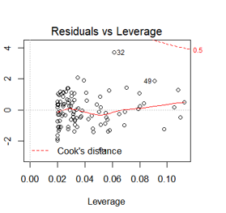
Influential Outliers
All points within the Cooks distance red dotted lines - so no evidence of influential outliers.
Notes:
REPLACE WITH ONE FOR DATA

Slide 49
Sensitivity Analysis
If you think an outlier might be having an undue influence or is impacting normality then do a sensitivity analysis.
This is a fancy way of saying you fit the model with and without the outlier and see if the model interpretation changes enough to be concerned. (Which is what Cooks distance does).
Keep in mind if there are multiple outliers, especially with a small sample, that removing a lot of data is changing the model!

Slide 50
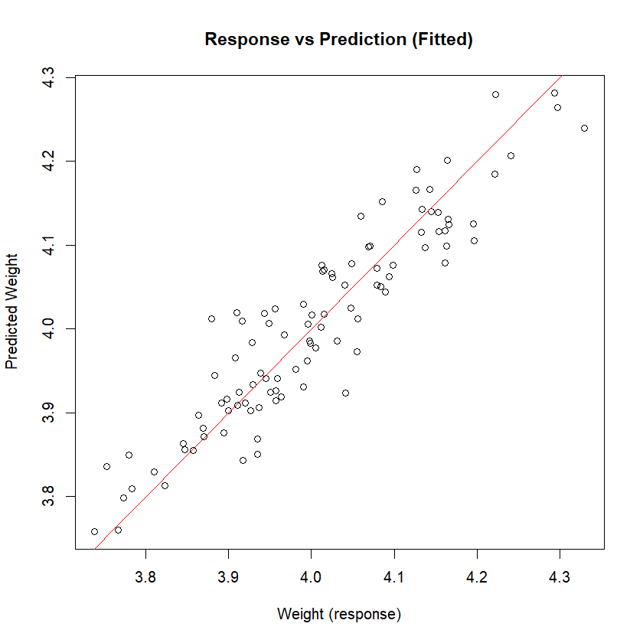
Step 4) Goodness of Fit: Plots and Statistics
So far we have established our model is an appropriate fit to our data and there is nothing obvious we have missed. The next question is How well does it predict i.e. fit, the data?
This plot is a good visual representation of model fit. If the response is being exactly predicted than we expect it to fall along the 1:1 line.
The correlation along this line is the most commonly used Goodness of Fit Statistic: called R². It is literally the correlation of the response and prediction squared. And represents the % of the responses variation the prediction i.e. model, explains. In this example it is 88%.
Notes:
QUESTION:: But is it the fit along the 1:! Line i.e. could the predicted be twice as much but a perfect linear fit and still get a 100% R-Squared???

Slide 51
What is a ‘good’ R²?
It’s totally domain specific, so take your benchmark from similar published work. It depends on how much natural variation we expect in the system. For example:
Market Research Consumer Purchase Intent and Liking: 70-90%
Ecological Communities: anything over 20% is fabulous!!

Slide 52
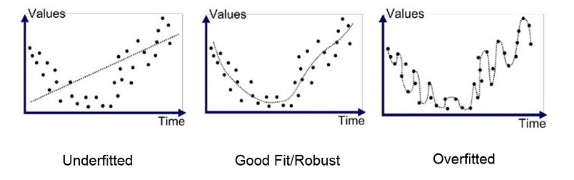
Why is a high R² bad: Overfitting leads to poor predictive power
Statistical models split the data into the underlying populations deterministic/systematic signal vs this samples random information/noise.
We want our model to be a good representation of the population’s deterministic patterns so we can infer what is happening outside our sample, and for any predictions to be accurate.
When R² is too big it suggests we have fit some of this samples unique noise/error/variation along with the population signal. So, although it is a good fit to this sample, it will be a poor fit to other samples and the population.
This is called Overfitting.
I question anything with an R² of greater than 90%. But again, it’s domain specific, if I had ecological community data model with an R² of greater than 80% I’d be checking for overfitting.
I
The overfitted model is a saturated model i.e. it has as many parameters as data (which is why the line goes through each datum). As such it tells us no more than the data and will usually be uninformative.
https://medium.com/@minions.k/underfit-and-overfit-explained-8161559b37db

Slide 53
Minimum Sample Size: 10 data points per parameter
A common cause of overfitting is having too many predictors compared to data points. This can also lead to unstable parameters with high SE.
A common rule of thumb to prevent this is to have at least 10 data points per parameter. Don’t forget the intercept is a parameter too!
EG: A simple linear regression with 1 predictor has 2 parameters (constant plus the predictors slope parameter) so usually requires 20 observations.
Refer to our Power and Sample Size workshop for more information on sample size considerations

Slide 54
Step 5) Interpret Model Parameters and reach a conclusion
FINALLY!! We can actually have a look at our model and see what it is telling us.
Realistically most people, including me, often do the EDA plots, pick the model they think best suits the data, plot it and then look at this model summary first.
And then go back to do all the above due above model due diligence.
Which is understandable, but just make sure you do it!!

Slide 55
So how do we use this equation to understand the relationship between our predictor and response?
We look at the Parameter estimates of the model.
Parameter | Estimate | SE | T score | P value | 95% Confidence Interval
 |  |  |  |  | Lower Bound | Upper Bound
Constant / Intercept (β_{ο}) | 1.03 | 0.136 | 7.6 | 2.24e-11 | 0.8 | 1.3
Feed (β1) | 0.50 | 0.023 | 21.8 | <2e-16 | 0.45 | 0.54
Model Fit is => Y_{i} = β_{ο} + X_{i}β₁ + ε_{i} => Weight = 1.03 + 0.50 * Feed + ε_{i}

Slide 56
Step 6) Reporting: Overall Conclusion suitable for publication
Always include these 2 things
1) Interpret the model and what it means for your research
There is strong evidence to show that feed influences weight (p<2e-16), with each kg of feed adding between 0.45-0.54 kg of weight (95% CI). This effect on weight has been estimated very accurately [as 95% CI is quite narrow].
2) Show that the model is a good fit and assumptions have been tested and met
The model is a good fit to the data with an R²=88%. There were no outliers or unexplained structure. The error was normal.
And when giving a p-value always give an estimate of the effect size as well i.e. the 95% CI.
This is because we don’t just care about statistical significance i.e. is the effect real. But also how big is the effect i.e. do I care? Also known as the difference between statistical significance and practical/clinical significance.

Slide 57
Step 6) Reporting: Overall Conclusion suitable for publication
So a suitable write up would be as follows
“There is strong evidence to show that feed influences weight (p<2e-16), with each kg of feed adding between 0.45-0.54 kg of weight (95% CI). This effect on weight has been estimated very accurately [as 95% CI is quite narrow].
The model is a good fit to the data with an R²=88%. There were no outliers or unexplained structure. The error was normal”

Slide 58

A Conversation is better than a Presentation
So please speak up and ask questions!
People think differently. So I may need to explain things in 2 or 3 different ways!

Slide 59

40
Notes:
Any Questions???

Slide 60
ANOVA: ANalysis Of VAriance
Continuous response, categorical predictor
Workflow Suitable for:
Modelling discrete predictors (workflow shown is for 1 predictor, there are additional considerations when more than 1 e.g. Confounding, these are discussed in our Model Building workshop)
Control vs Treatment designs
Randomised Control Trials (RCT)
Notes:
I’m about to show you a workflow that is suitable for all these things. So if you ever need to do this you can come back here and use this as a workflow.

Slide 61
Model Fitting Workflow
Step 0) Clean and check data.
Step 1) Pick a suitable model to fit to the data via Exploratory Data Analysis (EDA).
Step 2) Fit the Model
Step 3) Check Model Assumptions via Diagnostics: Residual Analysis
Step 4) Goodness of Fit: Plots and Statistics
Step 5) Interpret Model Parameters and reach a conclusion
Step 6) Reporting
Linear Models 3 and Model Building Workshops have more detail on many of these steps.

Slide 62

Step 1) Pick a suitable model to fit to the data via Exploratory Data Analysis (EDA)
Your Turn:
We have a chicken feed experiment where we added a protein supplement.
We expect the Control to have an average of 3kg, and the Treatment to add 0.5kg to weight. With a SE(mean) = 0.05 i.e. 95% of data is within 0.10 of the mean.
Plot the data!!

Slide 63
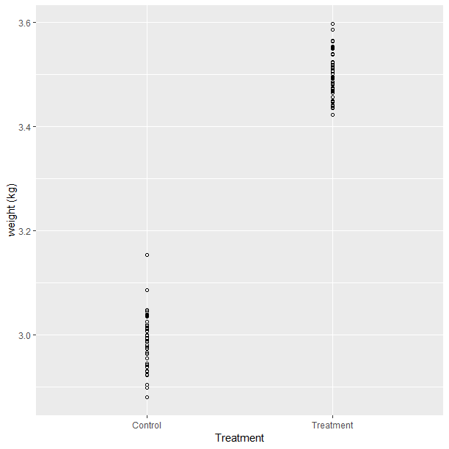
Step 1) Pick a suitable model to fit to the data via Exploratory Data Analysis (EDA)
ggplot(data = data1, aes(x=treatment, y=response)) +
geom_point(pch=21) +
labs(x="Treatment", y="weight (kg)")

Slide 64
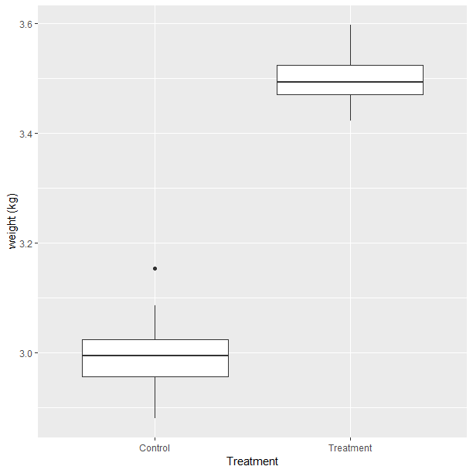
Step 1) Pick a suitable model to fit to the data via Exploratory Data Analysis (EDA)
This is an ANOVA: which is a type of Linear Model.
This may not look like a linear relationship, but it is a linear model. I will explain why later.
Boxplots need at least 12 datum. If not enough use dot plots as per the previous slide.
ggplot(data=data1, aes(x=treatment, y=response))+
geom_boxplot() +
labs(x="Treatment", y="weight (kg)")

Slide 65
Step 1) Pick a suitable model to fit to the data via Exploratory Data Analysis (EDA)
Independence: Consider your experimental design
Your Turn:
Is there anything about this design that might lead to datum being correlated with each other? For example, if we had repeated measures on the same patient (chicken) then we would expect these to be correlated i.e. dependant on each other.
YES! Chickens in the same treatment might be correlated, but our model will account for that since it’s fitting a different mean to the control vs treatment.
Other reasons might be: Blocked design, Split-Plot design, etc.

Slide 66
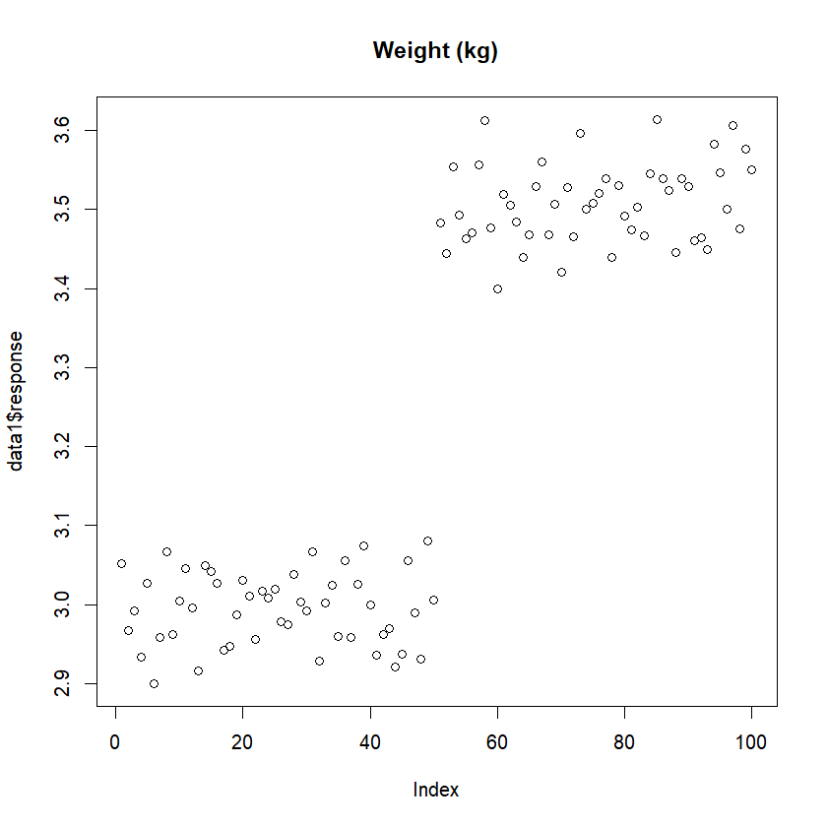
Step 1) Pick a suitable model to fit to the data via Exploratory Data Analysis (EDA)
Independence and Outliers: Plot the data using a Serial Plot
Notice the serial correlation i.e. data at the start are more similar to those at the end. As control data are at the beginning and treatment at the end this is expected. And our model will account for that.
No Outliers
plot(data1$response, main="Weight (kg)")

Slide 67
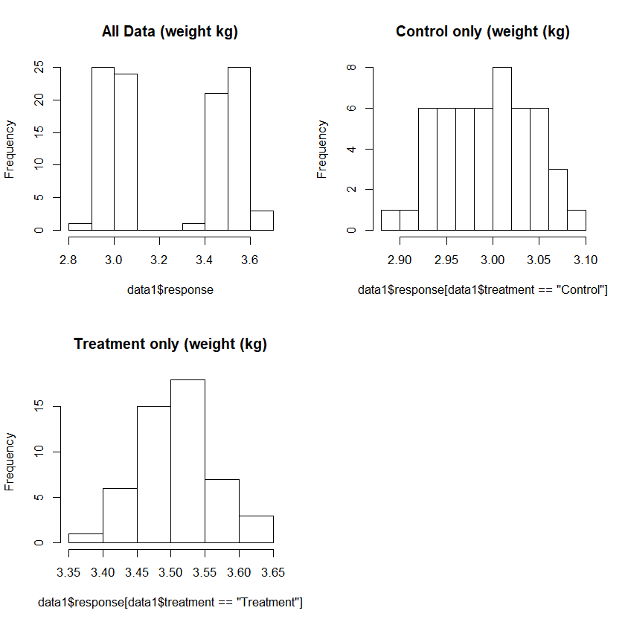
Step 1) Pick a suitable model to fit to the data via Exploratory Data Analysis (EDA)
Normality and Outliers
The combined data is clearly bimodal and is certainly not normal!!!
YR Turn: So do we have a problem??
NO: The error needs to be normal, not the response. And as we can see here the error about the mean of each treatment is roughly normal.
(Even though the control might not look like it we know it is since its simulated data. A good example of just how non–normal something can look and we’re still OK).
par(mfrow=c(2,2))
hist(data1$response, main="All Data (weight kg)")
hist(data1$response[data1$treatment=="Control"], main="Control only (weight (kg)")
hist(data1$response[data1$treatment=="Treatment"], main="Treatment (weight (kg)")

Slide 68
Step 2) Fit the Model
R Code:
lm.anova <- lm(data1$response~data1$treatment)

Slide 69
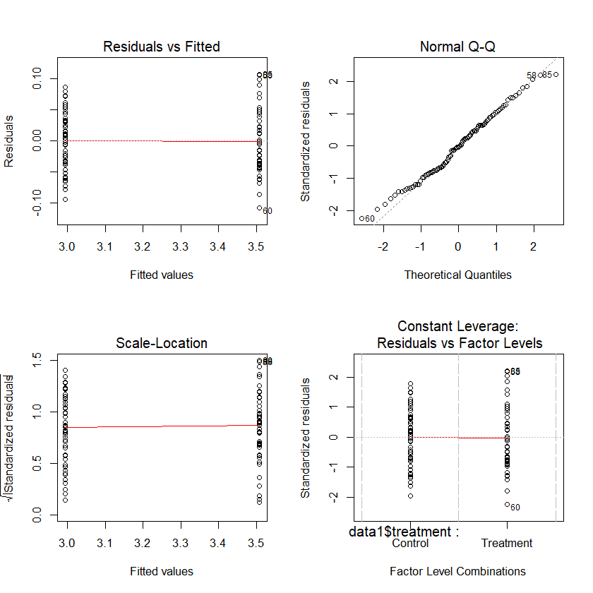
Step 3) Check Model Assumptions via Diagnostics: Residual Analysis
Normality
Residuals appear normal.
par(mfrow=c(2,2))
plot(lm.anova)

Slide 70
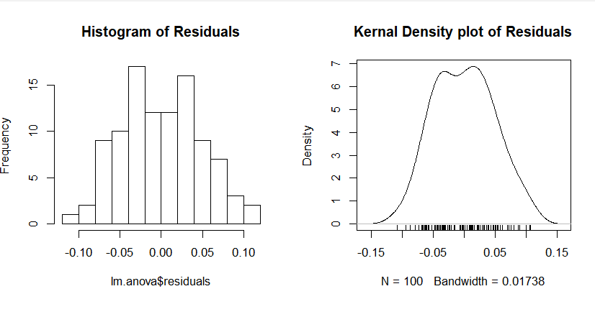
Step 3) Check Model Assumptions via Diagnostics: Residual Analysis
Normality
Residuals appear normal.
par(mfrow=c(2,2))
hist(lm.anova$residuals, main="Histogram of Residuals")
plot(density(lm.anova$residuals), main="kernel Density plot of Residuals")
rug(lm.anova$residuals)

Slide 71
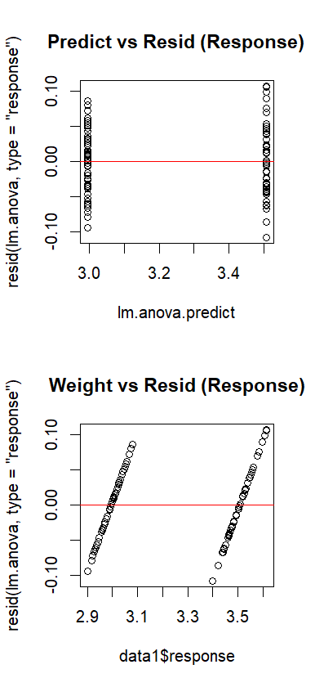
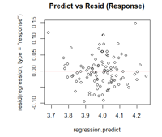
Step 4) Goodness of Fit: Residual Analysis
Outliers and unexplained structure or non linearity
No evidence of outliers, or unexplained structure or non linearity.
We expect the ‘lines’ of data rather than a random ‘cloud’ of data which we saw in the regression (bottom right chart). This is because rather than a range of predictions for each different value of the predictor (feed) we only get 1 prediction for control and another for treatment, hence 2 vertical lines in the upper chart.
And 2 diagonal lines in the bottom chart when the x axis is the actual response since these are different.
For comparison Linear Regression looks like this
The greater the difference between the groups the further these lines are apart.
par(mfrow=c(2,2))
plot(lm.anova.predict, resid(lm.anova, type="response"), main="Predict vs Resid (Response)") # response residuals
abline(h=0, col="red")
plot(data1$response, resid(lm.anova, type="response"), main="Weight vs Resid (Response)") # response residuals
abline(h=0, col="red")
Notes:
ADVANCED YR TURN: they should be diagonal left to right, why?? A: the prediction should be centred in the cloud of points. Those below the prediction are lower on the scale-so on the left, those above the prediction higher on the scale- so on the right.

Slide 72
CQ: If I had 4 treatments, how many lines would I have?
2 lines
4 lines
8 lines
12 lines
Correct, 1 line for each treatment

Slide 73
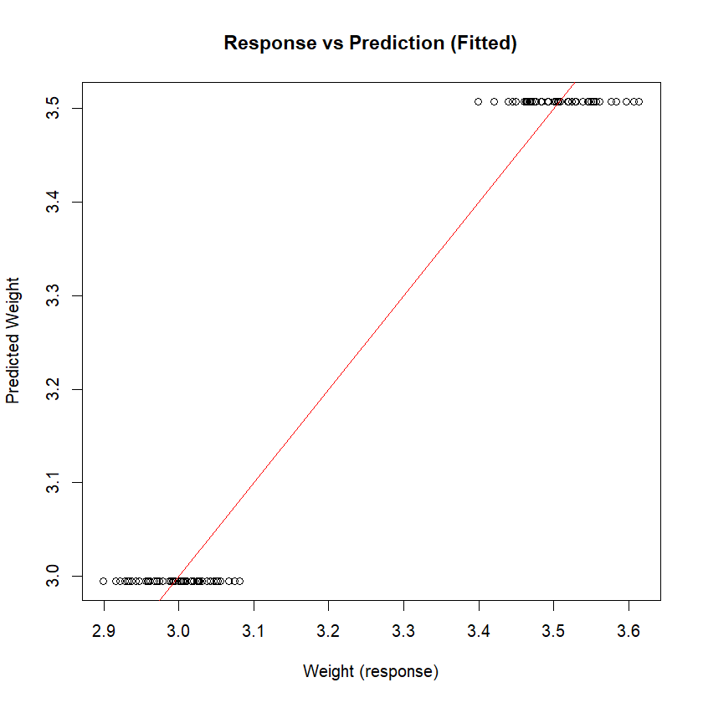
Step 4) Goodness of Fit: Plots and Statistics
For the same reason used previously we expect 2 lines of data here, not a cloud of points i.e. we only have 2 prediction.
We expect the 2 lines of data to be centred on the red line.
If they aren’t this suggests there is some bias to the fit worth investigating further.
For comparison Linear Regression looks like this
plot(data1$response, lm.anova.predict, main="Response vs Prediction (Fitted)", xlab="Weight (response)", ylab="Predicted Weight")
abline(a=0, b=1, col="red")

Slide 74
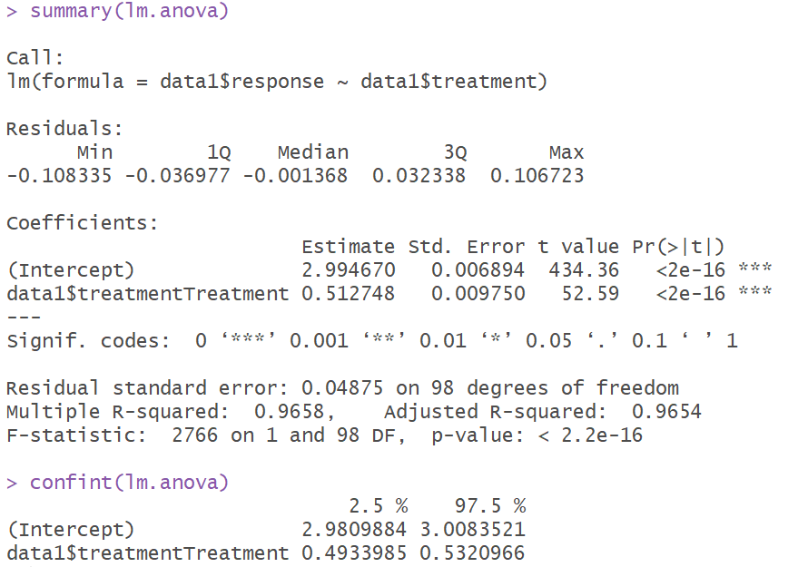
Step 5) Interpret Model Parameters and reach a conclusion
R CODE and output used to create Tables

Slide 75
Step 5) Interpret Model Parameters and reach a conclusion
Parameter | Estimate | SE | T score | P value | 95% Confidence Interval
 |  |  |  |  | Lower Bound | Upper Bound
Constant / Control (β_{ο}) | 3.00 | 0.0069 | 434 | <2e-16 | 2.98 | 3.01
Treatment Effect (β1) | 0.51 | 0.0098 | 53 | <2e-16 | 0.49 | 0.53
Model Fit is: Y_{i} = β_{ο} + X_{i}β₁ + ε_{i} (same as the previous linear regression) Weight = 3.00 + 0.51(if treatment) + ε_{i}

Slide 76
Step 6) Reporting: Overall Conclusion suitable for publication
“There is strong evidence to show that the Treatment influences weight (p<2e-16). It increases weight by between 0.49-0.53 kg (95% CI), from an average of approximately 3 (95% CI=2.98-3.01). This effect on weight has been estimated very accurately [as 95% CI is quite narrow].
The model is a good fit to the data with an R²=97%. There were no outliers or unexplained structure. The error was normal”
When giving a p-value always give an estimate of the effect size as well i.e. the 95% CI.
This is because we don’t just care about statistical significance i.e. is the effect real. But also how big is the effect i.e. do I care? Also known as the difference between statistical significance and practical/clinical significance.
NB: In the real world since R²=97% this is very likely a poor model due overfitting.
Notes:
Here’s an example of when R² is too high, and one might think the model has been overfit.

Slide 77

55
Notes:
Any Questions??

Slide 78
Combination of ANOVA and Regression
Continuous response, categorical and continuous predictors
Workflow Suitable for:
Modelling a combination of discrete and continuous predictors (workflow shown is for 1 of each type of predictor, there are additional considerations when more than 1 e.g. confounding and multicollinearity, , these are discussed in our Model Building workshop)
Modelling more than 1 regression line
To test if multiple regression lines are the same, or different.
ANCOVA: ANalysis of COVAriance
BACI (Before After Control Impact Designs)
Notes:
I’m about to show you a workflow that is suitable for all these things. So if you ever need to do this you can come back here and use this as a workflow.

Slide 79
Model Fitting Workflow
Step 0) Clean and check data.
Step 1) Pick a suitable model to fit to the data via Exploratory Data Analysis (EDA).
Step 2) Fit the Model
Step 3) Check Model Assumptions via Diagnostics: Residual Analysis
Step 4) Goodness of Fit: Plots and Statistics
Step 5) Interpret Model Parameters and reach a conclusion
Step 6) Reporting
Linear Models 3 and Model Building Workshops have more detail on many of these steps.

Slide 80
Step 1) Pick a suitable model to fit to the data via Exploratory Data Analysis (EDA)
Your Turn:
Say we wanted to do the previous 2 experiments at the same time.
Plot the data!
Reminder:
Experiment 1
A linear model for the weight of chicken compared to the amount of feed it eats in its first month.
Experiment 2
We added a protein supplement. We expect the Control to have an average of 3kg, and the Treatment to add 0.5kg to weight. The standard deviation = 0.05 i.e. 95% are within 0.10 of the mean.

Slide 81

“Graphs allow us to view complex mathematical models fitted to data, and they allow us to assess the validity of such (statistical) models” (Cleveland 1994, author of “The elements of graphing data” and “Visualising data”).

Slide 82
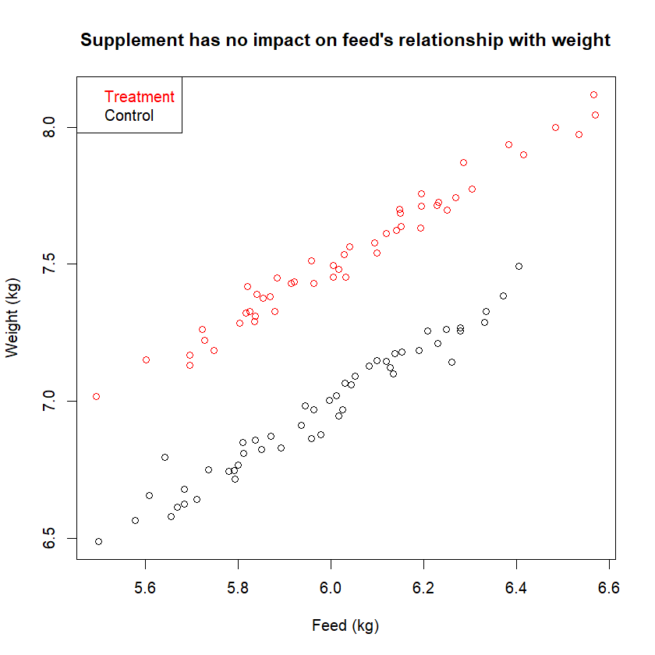

Step 1) Pick a suitable model to fit to the data via Exploratory Data Analysis (EDA)
So effect of feed is the same across treatment and control.
But what if they “interact”?
How do we fit this?

Slide 83
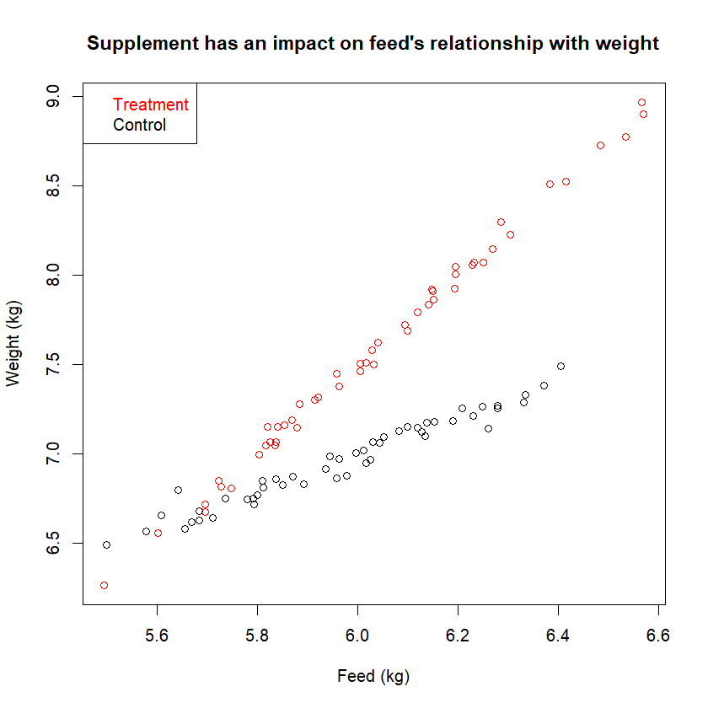
Yr Turn. But what if the protein supplement boosted the impact of feed. What would we see then? Draw it.
Now we see the treatment has little impact at the lower end feeding.
But as the amount we feed them increases it starts to have an impact.
Maybe because at the lower end they are only getting enough for basic development and they need more feed to really grow.
plot(data3$predictor.linear1, data3$response, xlab="Feed (kg)", ylab="Weight (kg)", main = "Supplement has an impact on feed's relationship with weight")
points(data3$predictor.linear1[data3$treatment=="Treatment"], data3$response[data3$treatment=="Treatment"], col="red")
legend(x="topleft", legend=c("Treatment", "Control"), text.col=c("red", "black"))

Slide 84
Different Interpretation
Parallel lines (ANCOVA)
We can talk about the consistent impact of the:
Protein treatment, in terms of the extra amount of weight it adds compared to the control
Feed, in terms of the extra amount of weight it adds for each kg of feed.
Non Parallel lines
As there is no consistent impact we need to talk about 2 different regression lines, each with a different impact of feed on weight.

Slide 85
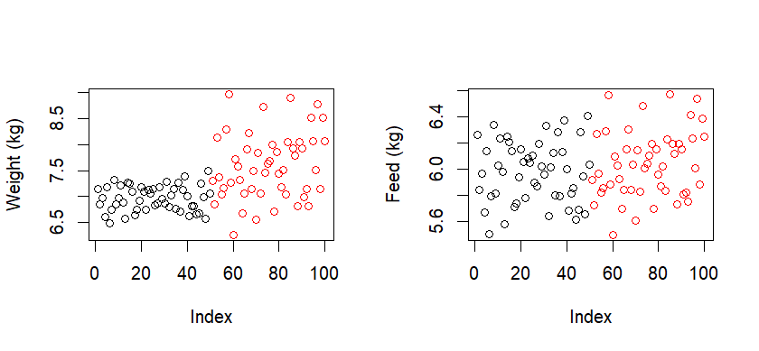
Step 1) Pick a suitable model to fit to the data via Exploratory Data Analysis (EDA)
Independence: Consider your experimental design and serial plot
As with the ANOVA we expect there might be dependence within each treatment for the response. However the linear predictors (feed) should be independent, if they’re not then we have a big problem!
par(mfrow=c(1,2))
plot(data3$response, col=ifelse(data3$treatment=="Treatment","red", "black"), ylab="Weight (kg)")
plot(data3$predictor.linear1, col=ifelse(data3$treatment=="Treatment","red", "black"), ylab="Feed (kg)")

Slide 86
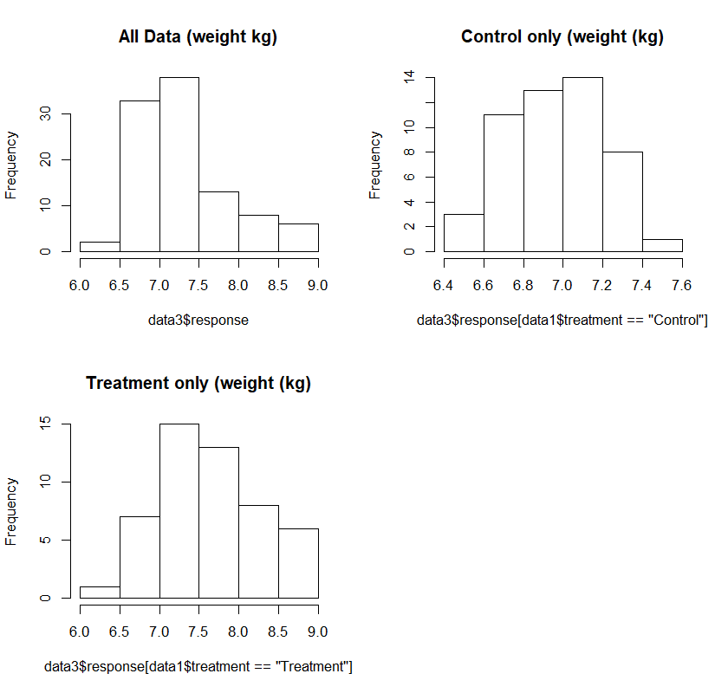
Step 1) Pick a suitable model to fit to the data via Exploratory Data Analysis (EDA)
Normality and Outliers
The combined data is clearly skewed and is certainly not normal!!!
Which is what we would expect given that both treatments have the same response at low Feed, but one of them has higher weight at a higher Feed.
If we didn’t include treatment this is an example of where our residuals might not be normal and it’s because of missing structure i.e. treatment.
par(mfrow=c(2,2))
hist(data3$response, main="All Data (weight kg)")
hist(data3$response[data1$treatment=="Control"], main="Control only (weight (kg)")
hist(data3$response[data1$treatment=="Treatment"], main="Treatment (weight (kg)")

Slide 87
Step 2) Fit the Model
R Code:
lm.ancova <- lm(data3$response~data3$treatment*data3$predictor.linear1)

Slide 88
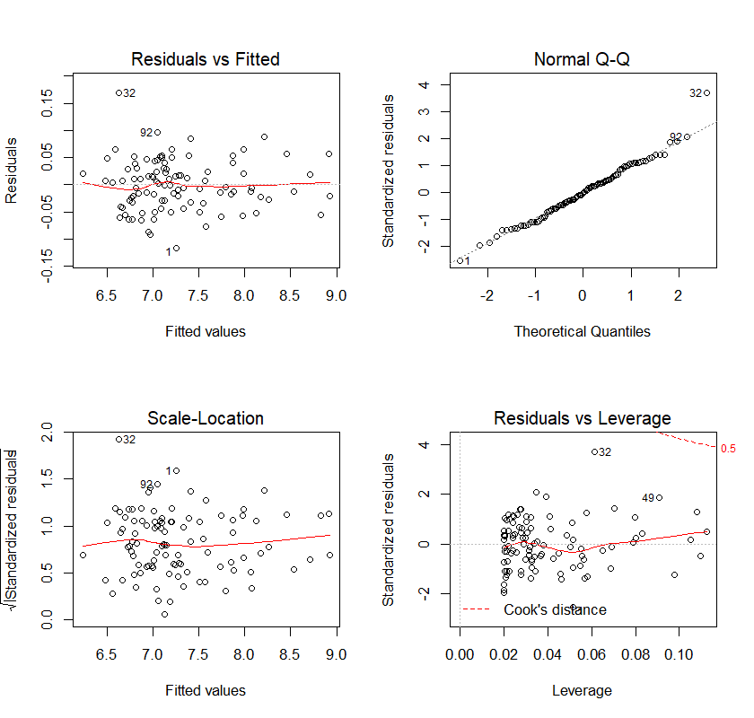
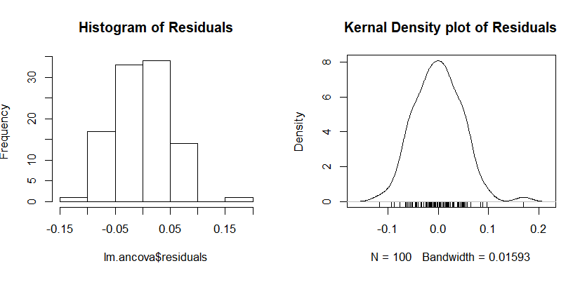
Step 3) Check Model Assumptions via Diagnostics: Residual Analysis
Normality Residuals appear normal.
par(mfrow=c(2,2))
hist(lm.ancova$residuals, main="Histogram of Residuals")
plot(density(lm.ancova$residuals), main="kernel Density plot of Residuals")
rug(lm.ancova$residuals)
par(mfrow=c(2,2))
plot(lm.ancova)

Slide 89
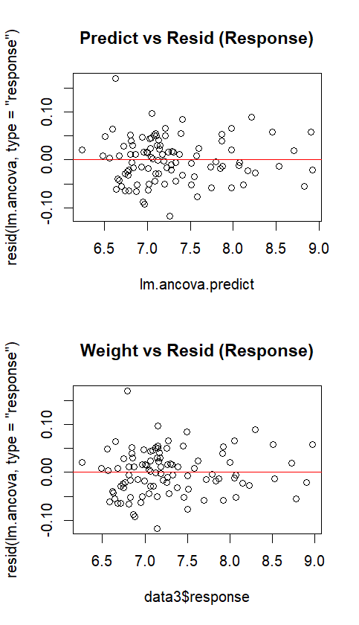
Step 4) Goodness of Fit: Residual Analysis
Outliers and unexplained structure or non linearity
No evidence of outliers, or unexplained structure or non linearity.
Although we don’t have the diagonal lines we saw in ANOVA it is possible. It occurs when the treatment has a much bigger effect than the linear predictor.
And notice that the data get’s a little sparse on the right, that’s because only the treatment has these high predictions, while both of them have the low ones.
par(mfrow=c(2,1))
plot(lm.ancova.predict, resid(lm.ancova, type="response"), main="Predict vs Resid (Response)") # response residuals
abline(h=0, col="red")
plot(data3$response, resid(lm.ancova, type="response"), main="Weight vs Resid (Response)") # response residuals
abline(h=0, col="red")
Notes:
ADVANCED YR TURN: they should be diagonal left to right, why?? A: the prediction should be centred in the cloud of points. Those below the prediction are lower on the scale-so on the left, those above the prediction higher on the scale- so on the right.

Slide 90
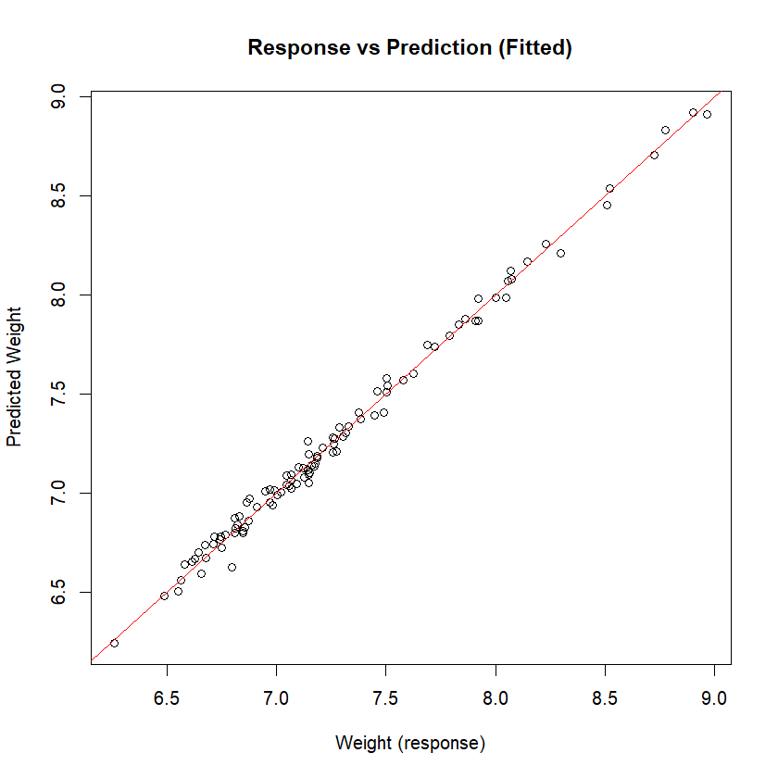
Step 4) Goodness of Fit: Plots and Statistics
Looks like a good fit!
plot(data3$response, lm.ancova.predict, main="Response vs Prediction (Fitted)", xlab="Weight (response)", ylab="Predicted Weight")
abline(a=0, b=1, col="red")

Slide 91
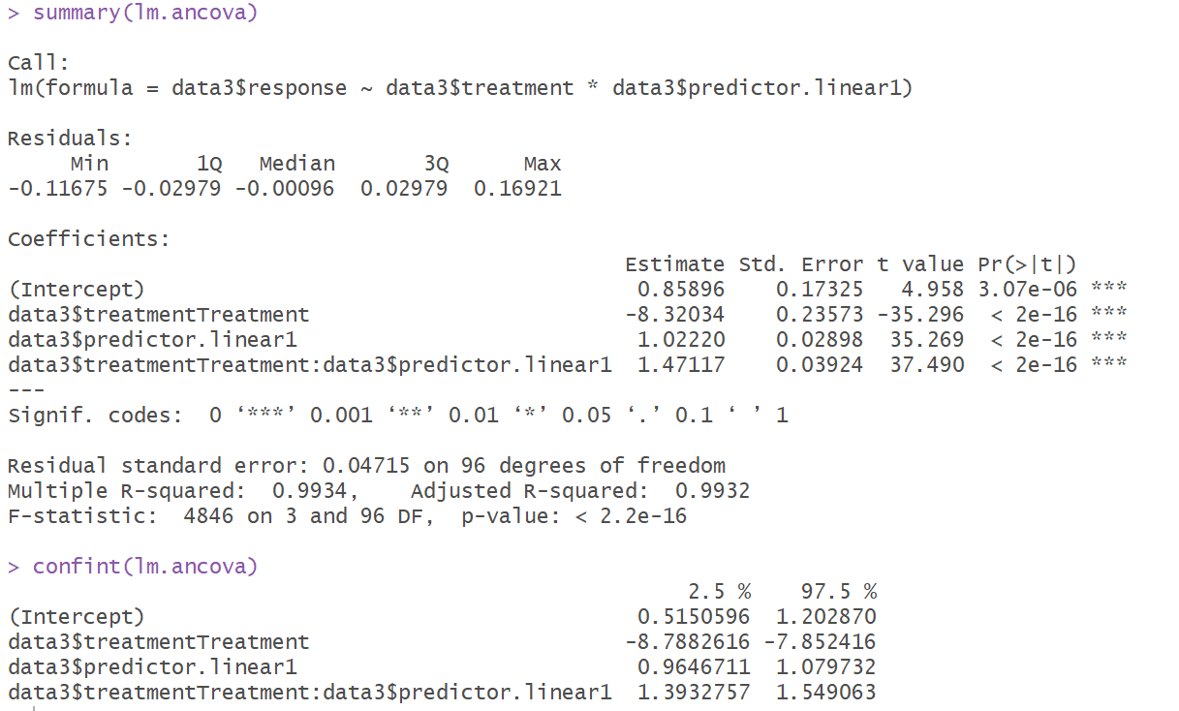
Step 5) Interpret Model Parameters and reach a conclusion
R CODE and output used to create Tables

Slide 92
Step 5) Interpret Model Parameters and reach a conclusion
Parameter | Estimate | SE | T score | P value | 95% Confidence Interval
 |  |  |  |  | Lower Bound | Upper Bound
Constant Control (β_{ο}) | 0.86 | 0.17 | 5 | <3e-6 | 0.51 | 1.2
Constant Adjustment Treatment (β₁) | -8.32 | 0.24 | -35 | <2e-16 | -8.8 | -7.9
Slope Control (β₃) | 1.0 | 0.029 | 35 | <2e-16 | 0.96 | 1.08
Slope Adjustment Treatment (β₄) | 1.5 | 0.039 | 37 | <2e-16 | 1.39 | 1.55
Model Fit is => Y_{i} = β_{ο} + X_{i}β₁ + X_{i}β₃ + X_{i}β₄+ ε_{i} => Weight = 0.86 + 1.0*Feed – 8.32(if treatment) + 1.5*Feed(if treatment) + ε_{i} Weight of Control (black data in chart) = 0.86 + 1*Feed + ε_{i} Weight of Treatment (red data in chart)= -7.46 + 2.5*Feed + ε_{i}

Slide 93
Step 6) Reporting: Overall Conclusion suitable for publication
“There is strong evidence to show that feed impacts weight (p<2e-16), with each kg of feed adding between 0.96-1.08 kg of weight (95% CI).
There is strong evidence that Protein supplements have a positive effect on the impact of Feed (p<2e-16), increasing its effect by between 1.39-1.55 (95% CI), for a total average effect of 2.5kg weight increase for each kg of extra Feed.
This effect of feed on weight has been estimated very accurately [as 95% CI is quite narrow].
The model is a good fit to the data with an R²=99%. There were no outliers or unexplained structure. The error was normal”
When giving a p-value always give an estimate of the effect size as well i.e. the 95% CI.
This is because we don’t just care about statistical significance i.e. is the effect real. But also how big is the effect i.e. do I care? Also known as the difference between statistical significance and practical/clinical significance.
NB: In the real world since R²=99% this is almost certainly a poor model due overfitting, or some other problem.
Notes:
Here’s an example of when R² is too high, and one might think the model has been overfit.

Slide 94
ANCOVA: is a special case of this model
Adjusts for continuous covariates so we get a clean read on the discrete predictors impacts. Often used in observational studies to help remove the effect of covariates.
For example: To understand the effect of the protein supplement after accounting for the different amount of feed each chicken ate we can add feed is a covariate in an ANCOVA. This would account for the scenario where chickens that had the supplement happened to eat more food and as such weighed more for that reason, not due to the supplement.
The key difference is that an ANCOVA makes an additional assumption called Homogeneity of covariate regression coefficients; i.e. “parallel lines model”. Which states that the regression lines must be parallel, i.e. the covariate has the same effect for each treatment.

Slide 95
ANCOVA: is a special case of this model
This allows us to measure the effect of each discrete parameter after accounting for the continuous covariate.
For example: The below model shows that the protein supplement increases the chickens weight by 0.5 kg, irrelevant to amount of feed it ate.
Statistically the Homogeneity of
covariate regression coefficients;
i.e. “parallel lines model” means
the interaction is not required in
the model.

Slide 96
ANCOVA: what happens when the homogeneity of regression covariates is failed?
Don’t worry! It’s not a big deal. It just means that the covariate doesn’t have a consistent effect overall treatments. Meaning we can’t directly compare the treatments overall effects with each other and instead need to look at each treatments regression line.
Statistically it’s the same model, but we also include an interaction.
So rather than the protein supplement consistently increasing weight by 0.5kg we see it has little impact at the lower end feeding.
But as the amount we feed them increases it starts to have an impact.

Slide 97

1:10
Notes:
This is you all looking a bit stunned!
Any Questions??
Googled quizical

Slide 98
Mixed Models: Random Intercept Model
Response is measured more than once on each respondent (observational unit)
Workflow Suitable for:
Modelling the variance associated with the respondents (observational units). Usually gives a more accurate analysis by partitioning out the noise/variance associated with the respondents (observational units).
Repeated Measures
Longitudinal Analysis
More advanced workflows suitable for:
    Cluster Designs
    More complex designs with repeated measures on clusters of observational units and experimental units
    Variance Decomposition
    Random Slopes
Notes:
I’m about to show you a workflow that is suitable for all these things. So if you ever need to do this you can come back here and use this as a workflow.

Slide 99
Model Fitting Workflow
Step 0) Clean and check data.
Step 1) Pick a suitable model to fit to the data via Exploratory Data Analysis (EDA).
Step 2) Fit the Model
Step 3) Check Model Assumptions via Diagnostics: Residual Analysis
Step 4) Goodness of Fit: Plots and Statistics
Step 5) Interpret Model Parameters and reach a conclusion
Step 6) Reporting
Linear Models 3 and Model Building Workshops have more detail on many of these steps.

Slide 100
Step 1) Pick a suitable model to fit to the data via Exploratory Data Analysis (EDA)
Your Turn:
Say we wanted to test the impact of a new drug on white blood cell counts in immune deficient people/dogs/Tasmanian tigers/chickens. We have 10 “people”, we take 5 measurements before the treatment and 5 after.
The white blood cell count is between 1000-7000 cells/micro litre (cells/μL). We expect the drug to increase white blood cell count by about 500 (cells/μL) to get it into the normal range. And within person variance is about 500 (cells/μL)
Plot the data!

Slide 101
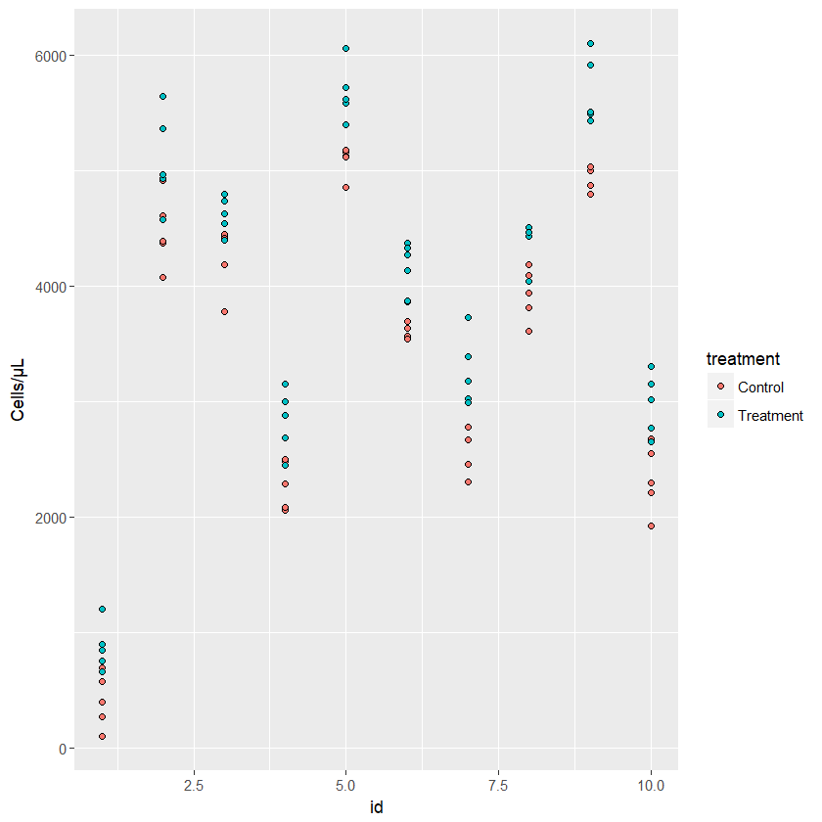
Step 1) Pick a suitable model to fit to the data via Exploratory Data Analysis (EDA)
Notice how the difference between people is much bigger than the effect of the drug?
The models so far ignore this information.
A Mixed Model that includes person as a random effect accounts for this. Effectively removing this extra variance and making the model more accurate.
This is a classic example of where mixed models out perform those that ignore this extra info i.e. when the difference between observational units is bigger than the effect we are looking for.
ggplot(data = data6, aes(x=id, y=response, fill=treatment)) +
geom_point(pch=21) +
labs(x="id", y="Cells (μL)")

Slide 102
Random Effects Benefits
Often reduce the noise by explicitly accounting for some of it.
It’s all about signal:noise ratio. If we can reduce the noise then we can detect a smaller signal, giving a more accurate model. Meaning that when random effects are added to a fixed effects model smaller effect sizes can be detected, we get smaller p-values for the same size effect and narrower confidence intervals (see example at section end).
Estimate the variation amongst units in the population e.g. is their more variance between classes, or between students within a class. This might have policy and teaching implications (Linear Models 2 has an example).
Don’t need to average repeated data to model it, which gives us more information.
Can account for imbalance, if correctly modelled by looking at the difference between people and modelling the average of each person. Rather than the average of all the datum, which is what a fixed effect does.
Notes:
Reference: Stat rethinking. benefits of multilevel models. 13.1 pg400

Slide 103
Random Effects Require
A categorical variable (not a continuous one-if your model is failing to converge or looks wrong check that this variable has been defined as a categorical one, not doing so is a common mistake) with a unique level for each sampling/experimental unit e.g. a variable called ID where each respondent has it’s own code (usually numeric such as ID1, ID2, ID3, etc)
Multiple observational units and repeated measures for each. We generally need at least:
  2 repeated measures within each observational unit
  5 observational units (so we can estimate their variance)
  So a minimum of 10 to fit each random effect

Slide 104
Random Effects: A more efficient use of your data
Say we want to understand the effects of new fishing nets on bycatch but remove the effect of different boats due to different levels of experience, technology and size. We have randomly sampled 10 boats from the entire NSW East Coast Fleet and measured the amount of bycatch from each for 2 treatments (existing and new nets).
We will always need at least 20 datum to estimate the effect of the 2 treatments (using the rule of thumb of 10 observations per fixed parameter).
The question is how much sample do we need to remove the effect of each boat's differences?
If we include each boat as a fixed effect i.e. old school blocking, then we need approximately 10 additional parameters (1 for each boat).
  For a total of 120 datum. Using the rule of thumb of 10 datum per fixed parameter we would need 100 for the 10 boats and 20 for the 2 treatments. However, technically we only need 11 parameters and 110 datum since we need 1 for the constant/control for Boat A, 1 for the treatment, and 9 for the other boats main effects.
But if we simply want to estimate the variance between the boats then all we need is 1 extra parameter, their variance as a random effect. We can do this by treating these boats as a random sample of all boats and since we don’t really care what each got.
  For a total of 20 datum (using the rule of thumb for 10 datum per fixed parameter we need 20 for the 2 treatments, and using the rule of thumb of a minimum of 5 boats with 2 repeated measures to estimate the variance). Note that this is a simple non additive example, some might say we actually need 30 datum as we are effectively estimating 3 parameters.
The point is that the random effects method can be used on a much smaller sample size than the blocking method using fixed effects.

Slide 105
Mixed models: Random & Fixed Effects
Fixed Effects
Standard models you are used to.
Measure a single fixed effect for each factor level i.e. 1 parameter for each factor level.
So, if we had 50 people and we want to understand the differences between them we need to estimate 50 fixed effects, 1 for each person. Which requires 50 parameters and using the rule of thumb of10 observations per parameter means we need a sample size of 500.
If we want to understand the differences between these specific factor levels (e.g. people, schools, farms, etc) then they should be a fixed effect.
Random Effects
Measures each factor levels difference from the overall average using a random variance e.g. to understand the overall difference of 50 people from their average we could use the variance of their 50 differences.
1 parameter for all people i.e. their variance. So 1 parameter in total.
  Meaning we need a much smaller sample size (at least 10 as per previous slide)
Usually added to a fixed effects model to make a mixed effects model. Or less often used by themselves to partition the variance.
Makes the model more accurate by partitioning out the variance associated with this factor.
If we don’t care about the differences between these specific factor levels (e.g. people, schools, farms, etc) and are just using them as a sample then they should often be random. In other words, if we can rerun the study using different factor levels and still be able to draw the same conclusions, than they are often best fit as random.

Slide 106

Challenge Question
A Random effect is a Variance Estimate, and what do you need to estimate a Variance?
  A) At least 1 data point
  Wrong, since n-1 = 0 and we can’t divide by 0.
  B) At least 2 data points
  Technically correct, BUT it won’t be very stable or accurate. Trying to estimate random effects with only 2 datum per observational unit will often fail to converge.
  C) At least 5 data points
  Often stated as the minimum # of observational units for the model to converge to a stable result.
  D) At least 30 data points
  Often used as the minimum sample size required to invoke the Central Limit Theorem to assume averages are normal. However not needed for random effects.
  E) At least 100 data points
  Don’t need this many
Notes:
Does it help if I add in the formula?

Slide 107
Step 1) Pick a suitable model to fit to the data via Exploratory Data Analysis (EDA): Independence
If we started with a plot that factored in our design then we can clearly see the lack of independence between the patients and treatments.
Notice how the difference between people is much bigger than the effect of the drug?
The models so far ignore this information.
A Mixed Model that includes person as a random effect accounts for this. Effectively removing this extra variance and making the model more accurate.
This is a classic example of where mixed models out perform those that ignore this extra info i.e. when the difference between observational units is bigger than the effect we are looking for.
ggplot(data = data6, aes(x=id, y=response, fill=treatment)) +
geom_point(pch=21) +
labs(x="id", y="Cells (μL)")
Notes:
But back to this example

Slide 108

Step 1) Pick a suitable model to fit to the data via Exploratory Data Analysis (EDA): Independence
But say we hadn’t factored in our experimental design like the preceding plot, maybe know one told us!?
If we followed this workflow we would have started with a serial plot to consider Independence.
And it would clearly show this clustering.
And if we saw something like this we would investigate and then realise it was due to the repeated measure and this is something we should include in our model.
Shows the importance of the serial plot and sticking to a workflow that starts with EDA.
ggplot(data = data6, aes(x=c(1:nrow(data6)), y=response)) +
geom_point(pch=21, fill="black", size=1) +
labs(x="order", y="Cells/µL")

Slide 109

Step 1) Pick a suitable model to fit to the data via Exploratory Data Analysis (EDA)
Normality and Outliers
Could be normal, however there does look like there might be a bit of a negative skew.
But as the assumption is the model errors are normal, not the response, we aren’t too worried about this. But it’s worth remembering and paying special attention to whether out model errors are normal.
windows()
par(mfrow=c(2,2))
hist(data6$response, main="All Data (Cells/μL)")
hist(data6$response[data6$treatment=="Control"], main="Control only (Cells/μL)")
hist(data6$response[data6$treatment=="Treatment"], main="Treatment only (Cells/μL)")

Slide 110
Sample Size calculations of repeated measures most consider Pseudo Replication.
Even though we have n=100 this isn’t really a lot of data.
Keep in mind that we only have 10 subjects, and then 10 repeated measures on each. So we have a type of pseudo replication.
So using the n=10 per parameter rule even though we have n=100 this doesn’t mean we can have 10 subject level parameters such as age. With only 10 subjects you’d be hard pressed to have even 2 groups with 5 in each.
Repeated measures might allow us to evaluate more complex models with a few parameters for longitudinal measures as we have more points to model a line to e.g. white blood Cells/µL = virus load + cholesterol.

Slide 111
Step 2) Fit the Model
R Code:
lm.mm2 <- lmer(response~treatment + (1|id), data=data6)
Where
  treatment ~ is the fixed effect
  (1|id) ~ is the random effect representing each person. It is often 1,2,3,4,5 i.e. 1=1st person, 2=2nd person. BUT must be a categorical variable (factor in R), not continuous.
Notes:
Speak “1 pipe id” for 1|id

Slide 112

Step 3) Check Model Assumptions via Diagnostics: Residual Analysis
Normality Residuals appear normal.
Standard plots we get from the R function lmer() to fit the model are different to what we get when we use lm(), which is what we have been using previously.
So we are missing the QQ plot, amongst others.
plot(lm.mm2)

Slide 113

Step 3) Check Model Assumptions via Diagnostics: Residual Analysis
Normality Residuals appear normal.
Looks pretty good.
Might be a bit of a left skew still, but likely not enough to worry about.
lm.mm2.residuals <- resid(lm.mm2, type="response")
windows()
par(mfrow=c(2,2))
hist(lm.mm2.residuals, main="Histogram of Residuals")
plot(density(lm.mm2.residuals), main="kernel Density plot of Residuals")
rug(lm.mm2.residuals)
qqnorm(lm.mm2.residuals)

Slide 114

Step 4) Goodness of Fit: Residual Analysis
Outliers and unexplained structure or non linearity
No evidence of outliers, or unexplained structure or non linearity.
Notice the predicted scores are falling out into 20 discrete vertical patterns of 5 points. This is expected since we had 5 repeated measures for 10 patients over 2 treatments.
par(mfrow=c(2,1))
plot(lm.mm2.predict, resid(lm.mm2, type="response"), main="Predict vs Resid (Response)") # response residuals
abline(h=0, col="red")
plot(data6$response, resid(lm.mm2, type="response"), main="Weight vs Resid (Response)") # response residuals
abline(h=0, col="red")
Notes:
ADVANCED YR TURN: they should be diagonal left to right, why?? A: the prediction should be centred in the cloud of points. Those below the prediction are lower on the scale-so on the left, those above the prediction higher on the scale- so on the right.

Slide 115

Step 4) Goodness of Fit: Plots and Statistics
NB: comes from the R workflow, which uses slightly different data to what was used here. Included to illustrate the type of plot we expect to see.

Slide 116

Step 5) Interpret Model Parameters and reach a conclusion
R CODE and output used to create Tables

Slide 117
Step 5) Interpret Model Parameters and reach a conclusion
Parameter | Estimate | SE | T score | P value | 95% Confidence Interval
 |  |  |  |  | Lower Bound | Upper Bound
Control (β_{ο}) | 4209 | 500 | 8 | 1.4e-5 | 3182 | 5237
Adjustment Treatment (β₁) | 522 | 44 | 12 | <2e-16 | 435 | 609
Standard Deviation(SD) between patients | 1580 |  |  |  | 1021 | 2504
Standard Deviation(SD) within patients | 222 |  |  |  | 192 | 257

Slide 118
Step 6) Reporting: Overall Conclusion suitable for publication
“There is strong evidence to show that the Treatment influences white blood cell count (p<2e-16). On average it increases # of white blood cells by between 435-609 cells/μL (95% CI). This effect has been estimated fairly accurately [as 95% CI isn’t too wide].
The population average of white blood cells for a patient is between 3182-5237 cells/μL (95% CI). This is not a particularly accurate estimate, and is to be expected with only 10 people being used to estimate it.
There was much larger variation between patients (sd=1580) than within (sd=222), meaning it was worthwhile partitioning it out for a more accurate model.
There were no outliers or unexplained structure. The error was normal”
When giving a p-value always give an estimate of the effect size as well i.e. the 95% CI.
This is because we don’t just care about statistical significance i.e. is the effect real. But also how big is the effect i.e. do I care? Also known as the difference between statistical significance and practical/clinical significance.
Notes:
The model is a good fit to the data with an R²=.

Slide 119











Was it worth fitting the more complex model?
If we fit a simple ANOVA model like we did previously it shows marginal support that the treatment has an impact (treatment p=0.052) while the random model has strong support (p < 2e-16). This is because the effect of treatment has been hidden by the noise in the data set (residual=1435), while the residual for the random model is much smaller (221.8) meaning it has more power. This is because the differences between subjects is included in the fixed effects residual, but is partitioned out in the random effects as the id-intercept standard deviation (1579.5).
So fitting the more complex repeated measures model has shown us something the simpler ANOVA model cannot.
FIXED MODEL
RANDOM MODEL
TAKE HOME
A mixed model can be the difference between a p-value low enough to publish, and one so high publication is not possible (0.05 vs <2e-16).
It does this by reducing the noise (dropped from 1435 vs 221.8) and making the signal easier to detect (which is about the same 56 vs 522).

Slide 120

Was it worth fitting the more complex model?
If we fit a simple ANOVA model like we did previously it shows marginal support that the treatment has an impact (treatment p=0.052) while the random model has strong support (p < 2e-16). This is because the effect of treatment has been hidden by the noise in the data set (residual=1435), while the residual for the random model is much smaller (221.8) meaning it has more power. This is because the differences between subjects is included in the fixed effects residual, but is partitioned out in the random effects as the id-intercept standard deviation (1579.5).
So fitting the more complex repeated measures model has shown us something the simpler ANOVA model cannot.
FIXED MODEL
RANDOM MODEL
TAKE HOME
The mixed effects model also estimates the treatment effect 6 times more accurately with its SE being 44 compared to the fixed effects 287!
This translates to a much narrower 95% CI for the treatment:
Mixed effects 95% CI = [433, 611]
Fixed effects 95% CI = [-10, 1138]
Mixed effects CI width is 177 vs fixed effects 1148.

Slide 121
Further Reading: Mixed Models Introduction
Online articles, books, journal articles and workshops from the Analysis Factor, with many articles by Karen Grace-Martin. https://www.theanalysisfactor.com/resources/by-topic/mixed-multilevel-models/
Introduction to concepts you need to understand to successfully run a mixed or multilevel model: https://www.theanalysisfactor.com/concepts-you-need-to-understand-to-run-a-mixed-or-multilevel-model/
Random vs Fixed effects https://www.theanalysisfactor.com/specifying-fixed-and-random-factors-in-mixed-models/
What is a covariance matrix? And common covariances structures such as: https://www.theanalysisfactor.com/covariance-matrices/
  Compound Symmetry variances are equal to each other, and co-variances are equal to each other. Makes sense if it’s the same variable measured in different groups, but not if the variables are on different scales.
  Variance Components is when variances differ, and covariances are 0 e.g. 4 different unrelated variables have been measured.
  Unstructured Covariance is when all entries can be different.

Slide 122
Further Reading: Repeated Measures ANOVA vs Mixed Models
Six differences between repeated measures ANOVA and Linear Mixed Models (LMM’s). 1 big advantage of LMM’s is they handle missing data and unbalanced groups much better. https://www.theanalysisfactor.com/six-differences-between-repeated-measures-anova-and-linear-mixed-models/
The difference between modelling repeated measures (repeated measures ANOVA) vs random effects (mixed models). https://www.theanalysisfactor.com/mixed-models-repeated-measures-g-side-r-side/
Random effects model the random effects covariance matrix known as G matrix (aka D matrix).
Repeated measures model the multiple residuals for each subject using the Sigma matrix (aka R or repeated matrix).
How mixed models and repeated measures ANOVA fit unstructured covariance matrices https://www.theanalysisfactor.com/unstructured-covariance-matrix-when-it-does-and-doesn%e2%80%99t-work/

Slide 123
Further reading: Linear Model III covers
Random slopes.
Using the same variable as a fixed and random effect.

Slide 124

1:25
Notes:
Any Questions??
Google confused looking animals

Slide 125
Other Resources

Slide 126

Further Assistance: Sydney University
SIH
1on1 Consults can be requested on our website:
www.sydney.edu.au/research/facilities/sydney-informatics-hub.html OR Google “Sydney Informatics Hub” with the “I’m feeling lucky” button
Training Sign up to our mailing list to be notified of upcoming training: https://signup.e2ma.net/signup/1945889/1928048/
  Research Essentials
  Experimental Design
  Power Analysis
Online library. Useful links and the most recent version of all our workshops.
  https://sydney-informatics-hub.github.io/stats-resources/
Hacky Hour
www.sydney.edu.au/research/facilities/sydney-informatics-hub/workshops-and-training/hacky-hour.html OR Google “Sydney Hacky Hour”
OTHER
Open Learning Environment (OLE) courses
  Science: OLET5608 Linear Modelling: Exploratory data analysis, sampling, simple linear regression, t-tests and confidence intervals. Ability to perform data analytics with coding, basic linear algebra.
  Business: BSTA5007 Linear Models
  Many others, and constantly changing, so have a look at what is available by getting the list and searching for key words such as linear, regression, GLM, ANOVA, etc.
Linkedin Learning: https://linkedin.com/learning/
  SPSS https://www.linkedin.com/learning/machine-learning-ai-foundations-linear-regression/welcome?u=2196204

Slide 127
Other SIH workshops
Linear Models 1: Basic intro to Linear models with a normal (gaussian) error. Example workflows for Simple Linear Regression, ANOVA, ANCOVA, mixed models.
Linear Models 2: Extends the Linear Model framework introduced in LM1 to Generalised Linear Models which allow non normal errors and responses. Example workflows for Poisson (Count) and Logistic (Binary) regression.
Linear Models 3: Shows how to build interpretable models and analyse data to extract insightful & impactful patterns which enable you to make the impactful discoveries that expand our knowledge, and how to craft engaging research stories to communicate those discoveries.
Model Building: LM workshops use simple 1 or 2 predictor examples. More than this requires additional Workflow steps and possibly different Methods to account for things like Multi-Collinearity. These additional topics are covered in this workshop.

Slide 128
Linear Models 3: How to build interpretable models and analyse data to extract insightful & impactful patterns, and craft an engaging research story
Statistical analysis is more than just building the best predictive model, it should also enable you to make impactful discoveries that expand our knowledge. Constructing engaging narratives about your research is also invaluable as you look to connect with your field, the community and funding bodies. To do this you need to build interpretable models, test hypotheses, uncover insightful & impactful patterns, and present results in insightful, intuitive and memorable ways. In this workshop we explore tips and tricks to make your research do just that. Topics covered will be:
Building impactful real-world recommendations and guidelines – i) why we need to understand both stated and model derived importance, ii) how Quadrant Analysis uses both variable performance and importance to develop impactful real-world recommendations and guidelines.
Reporting tricks that extract insightful & impactful patterns and craft engaging stories – i) establishing the importance of a predictor/risk factor, ii) confidence vs prediction intervals, iii) applying and correcting for multiple comparisons, iv) testing different hypothesis using different model parameterisations of the design matrix, v) interpreting categorical predictors - dummy vs effects coding and estimated marginal means, plus other reporting and interpretation tricks.
Building interpretable models – it’s quite common for researchers to incorrectly use model parameters to establish variables ‘impact’ or ‘importance’ . We show how multi-collinearity prevents this interpretation, and how to assess and then fix it so parameters can be used to identify important predictor/risk factors and other insightful patterns.
Mixed models – extend the Linear Model 1 intro to: i) better explain how mixed models work, ii) use them to test population wide hypotheses outside your sampled groups, and iii) use a random slope (with examples of the patterns it can explain and hypotheses it can test).
Using data visualisation to report complex nonlinear models graphically and aid pattern extraction

Slide 129
Further Assistance
  VIDEOS
  StatsQuest with Josh Starmer
    Linear Models: https://www.youtube.com/playlist?list=PLblh5JKOoLUIzaEkCLIUxQFjPIlapw8nU
    What is a Statistical Model https://www.youtube.com/watch?v=yQhTtdq_y9M
  Zedstatistics, longer videos than StatsQuest. https://www.youtube.com/c/zedstatistics
  WEBSITES
  R GLMM FAQ https://bbolker.github.io/mixedmodels-misc/glmmFAQ.html
  BOOKS AND PAPERS
  Faraway, Julian James. (2016) Extending the Linear Model with R : Generalized Linear, Mixed Effects and Nonparametric Regression Models.
  Fox, John. (2016) Applied Regression Analysis and Generalized Linear Models.

Slide 130
Tricks to learning – R, linear models, SPSS, etc
The trick is doing a little bit everyday and getting really good at it so by the time you get to actually needing R you are comfortable in it.
When working an actual problem let yourself ‘process’ problems overnight. I’ve lost count of the time times I have battled for hours only to wake up the next day and nail it.
As tempting as it is. Don’t just google stuff, if you get to know your books and references it will give you a broader understanding, which will help you in the long run.
Create an R script with your ‘training code’. So as you read the book jump into R and try stuff out. Get used to creating sample data to test stuff out.
And I’ll leave you with a paraphrased quote from one of the R guru’s Hadley Wickham “Frustration is good, it means you’re at the edges of your understanding and are learning!!”

Slide 131
R: Where to start
BOOKS
Find an intro R book
  Read it a little bit everyday, try and get a routine going such as a little at breakfast, before bed, whatever.
I like this one for a good intro that includes a lot of statistical methods
  Kabacoff, Robert (2015) R in Action: Data Analysis and Graphics with R. It also has a great web page resource which is a good first port of call too
    https://www.statmethods.net/
    Buy through Web site for a discount
Only downside is that it doesn’t use Hadley Wickhams packages, so I would also recommend one of his. In particular R for Data Science gives a great intro to data wrangling and visualisation using his packages. (Wickham, Hadley, and Garrett Grolemund (2017) R for Data Science Import, Tidy, Transform, Visualize, and Model Data)
Finally I recommend MASS (Modern Applied Statistics with S-Plus) by Veneables and Ripley. The ‘Yellow Bible’. It has at least a little bit on pretty much any statistical method you can think of. I tend to start here to get an intro on what R can do and then research outwards. (Venables, W. N, and B. D Ripley (2013) Modern Applied Statistics with S-Plus)
ONLINE
Lots of short (and long) YouTube courses
  EXPLORE, find a style you like and watch a little each day if too long.

Slide 132
Further R resources
There is a large online community of R users contributing to free ‘packages’ with data analysis functions, which leads to many ways of coding your analysis in R. This can be confusing. We recommend using tidyverse packages and tidy-centric code.
See our SIH helpful links for guides on using R and Rstudio.
LinkedIn Learning: R courses
  Including Learning the R Tidyverse (2024), Complete Guide to R: Wrangling, Visualizing, and Modelling Data, and Cleaning Bad Data in R.
RLadiesSydney: RYouWithMe

Slide 133
Acknowledging SIH
All University of Sydney resources are available to Sydney researchers free of charge. The use of the SIH services including the Artemis HPC and associated support and training warrants acknowledgement in any publications, conference proceedings or posters describing work facilitated by these services.
The continued acknowledgment of the use of SIH facilities ensures the sustainability of our services.
Suggested wording:
General acknowledgement:
"The authors acknowledge the technical assistance provided by the Sydney Informatics Hub, a Core Research Facility of the University of Sydney."
Acknowledging specific staff:
“The authors acknowledge the technical assistance of (name of staff) of the Sydney Informatics Hub, a Core Research Facility of the University of Sydney.”
For further information about acknowledging the Sydney Informatics Hub, please contact us at sih.info@sydney.edu.au.

Slide 134

We value your feedback
We will email you a link to the survey shortly
It only takes a few minutes to complete (really!)
Completing this survey is another way to help us keep providing these workshop resources free of charge

Slide 135

Notes:
Short 5 min break

